Slide 1


HILLSIDE AYURVEDIC MEDICAL COLLEGE
&
HOSPITAL
ANNUAL REPORT 2024-25

Slide 2
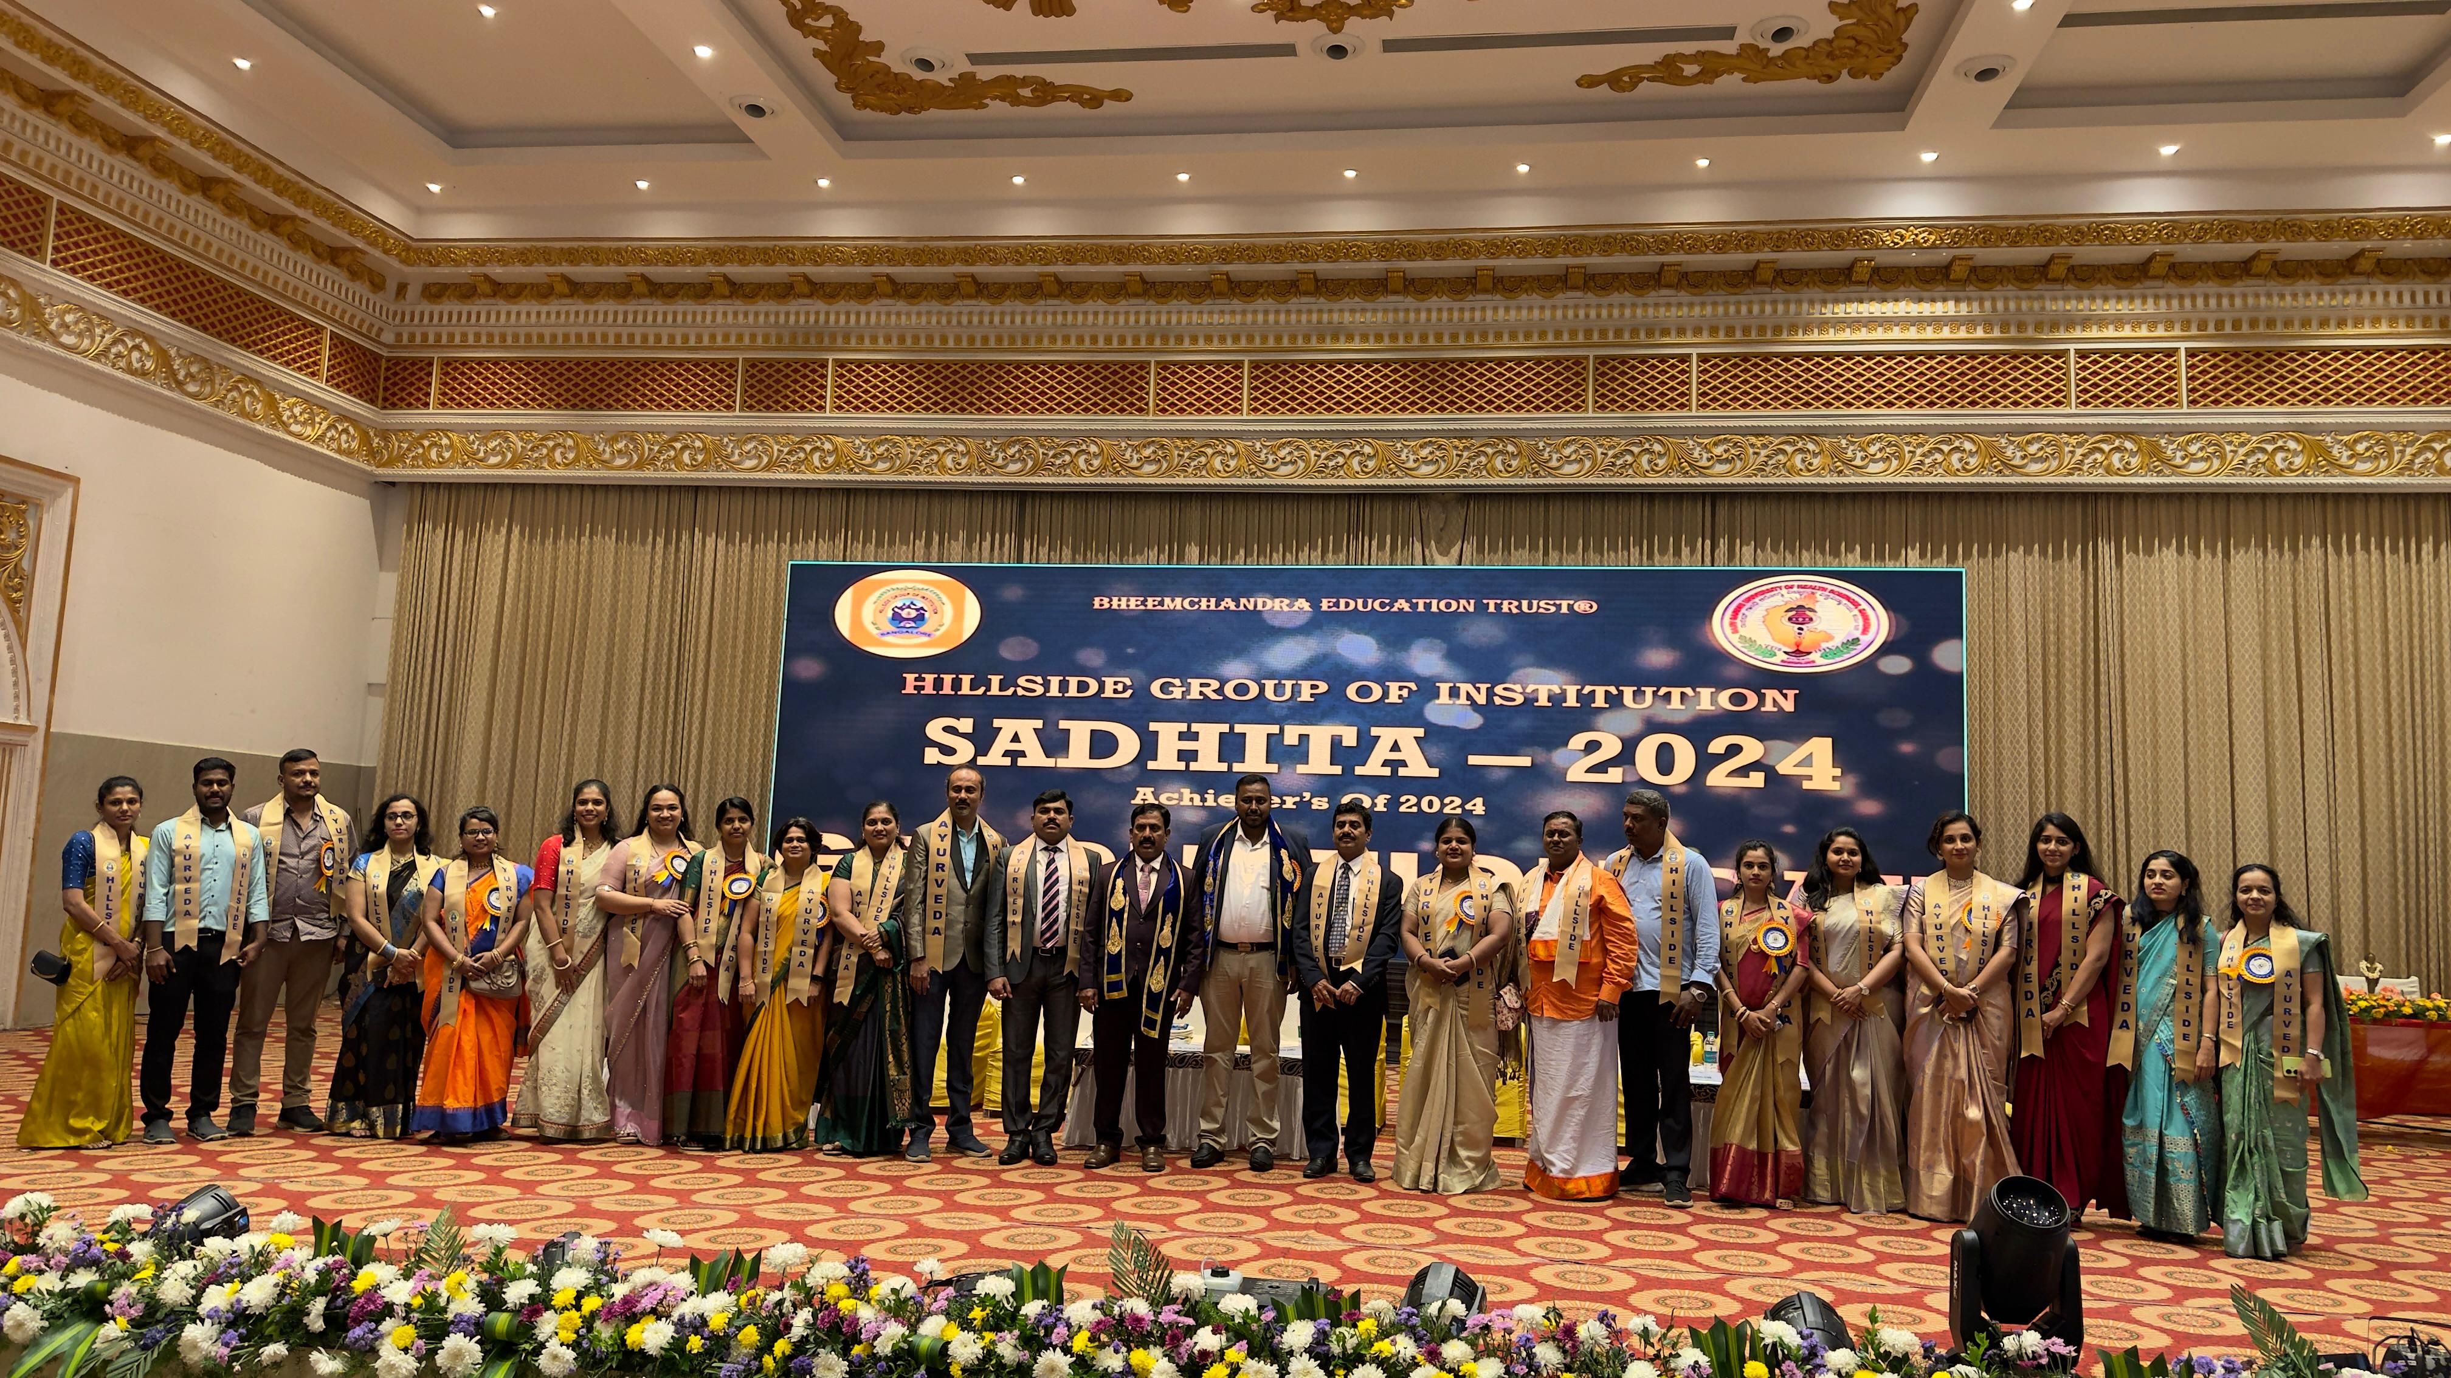
“SAdhita 2024”

Slide 3
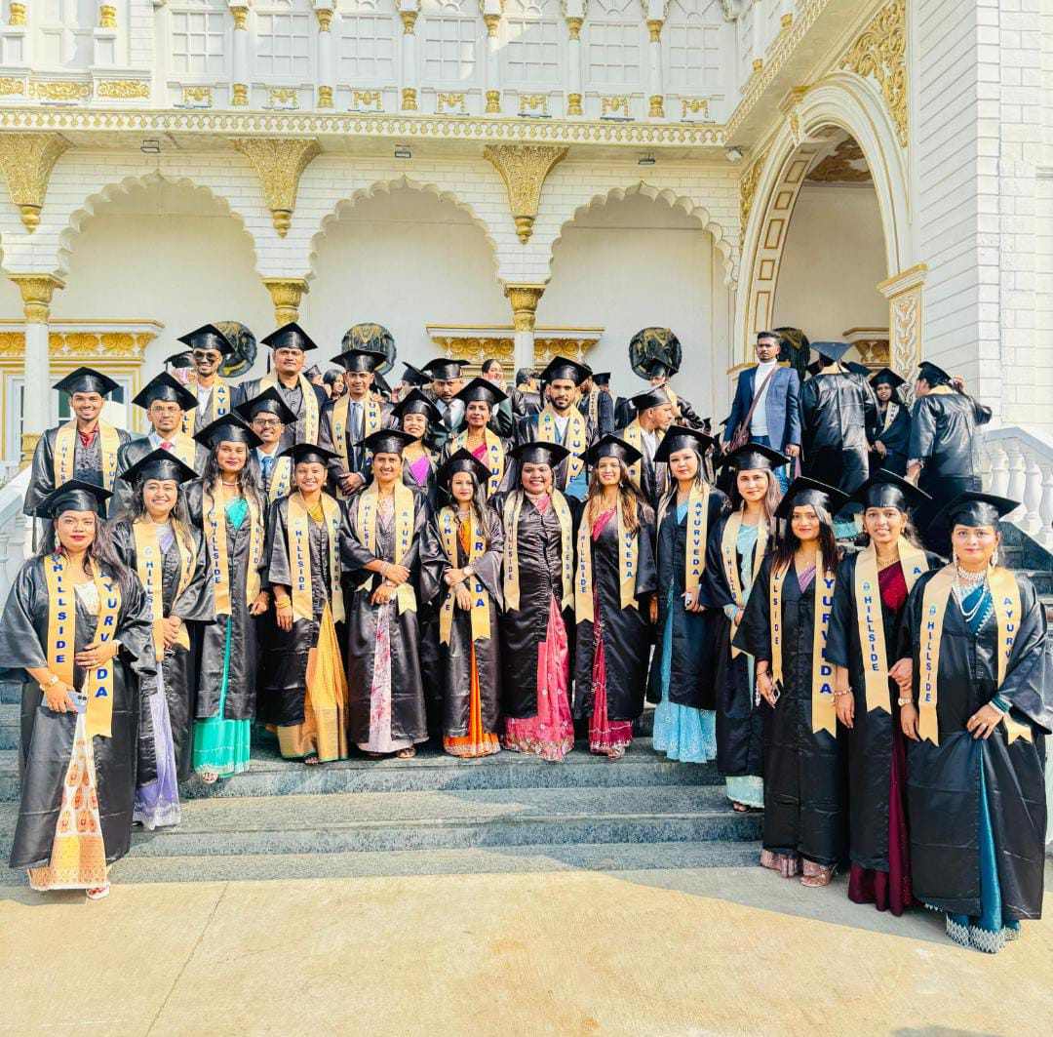
Achiever of
“2024”

Slide 4
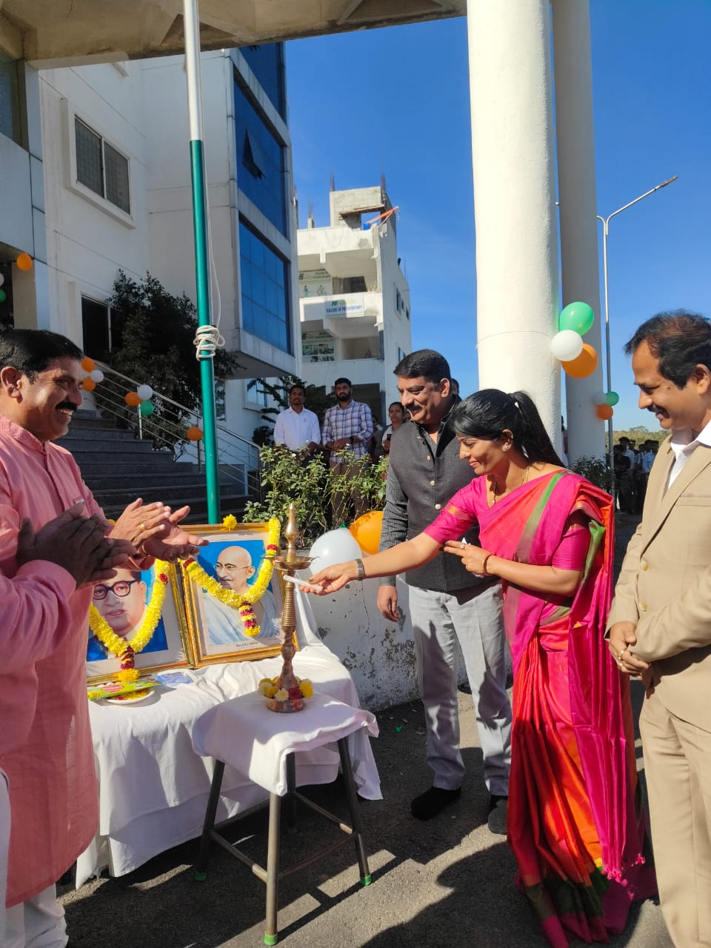
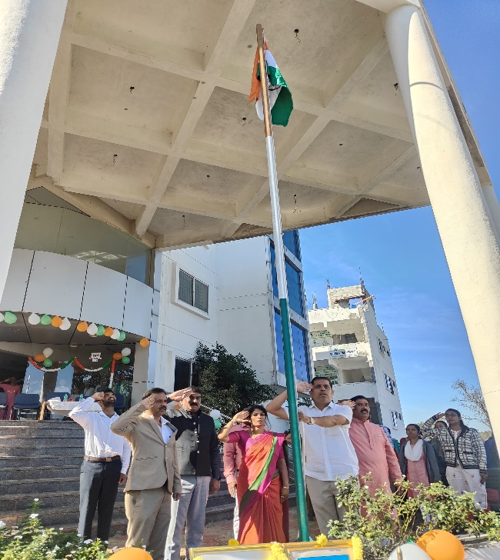
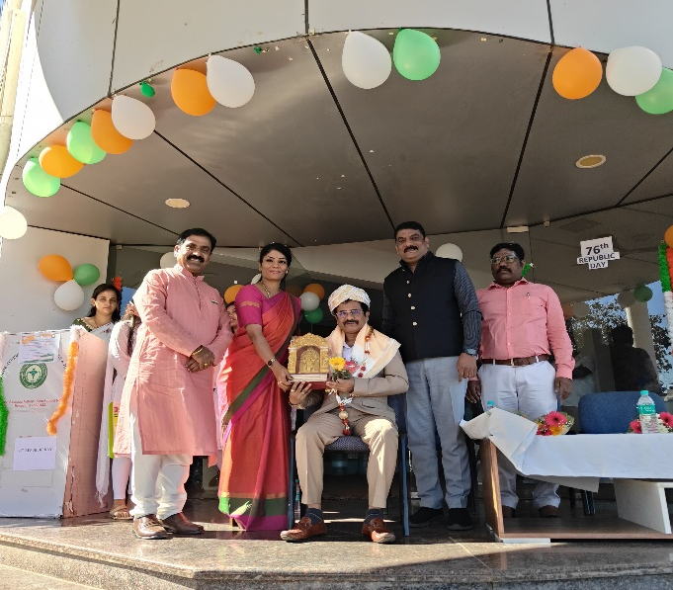
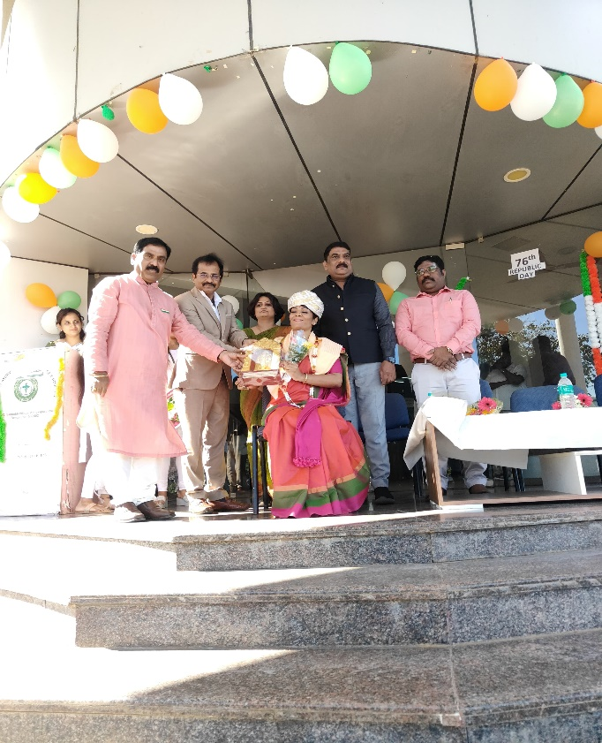
REPUBLIC DAY
76th Republic day was held on 26.01.2025 at Assembly Hall of HAMCH, Bengaluru, followed by a speech by Dr Chandrashekhar, managing trustee Suraksha blood centre and Mrs Latha Manjunath president of grama panchayat about Republic India

Slide 5
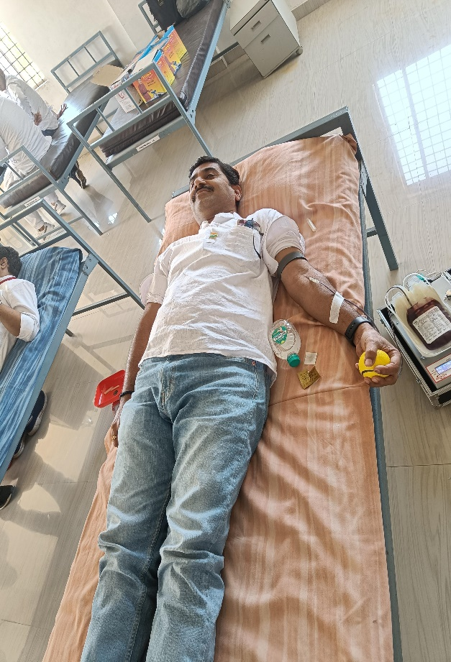
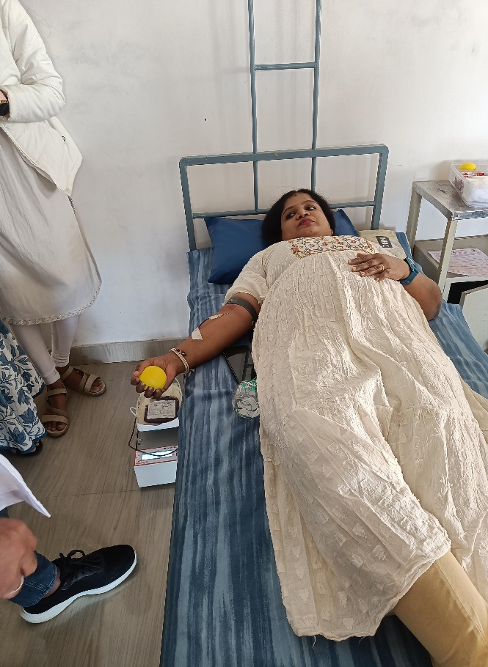
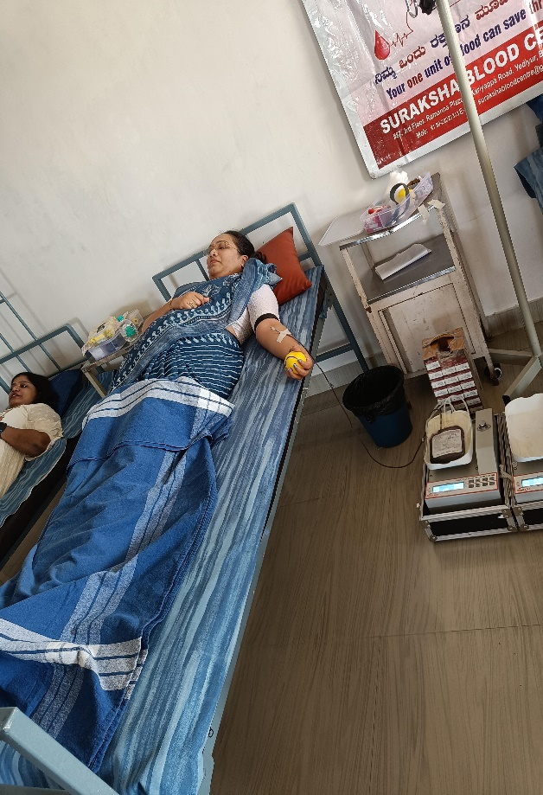
BLOOD DONATION CAMP
On the occasion of Republic Day, the NSS committee of HAMCH organized Blood Donation Camp in Association with Suraksha Blood Centre
R
A
K
T
D
A
N

Slide 6
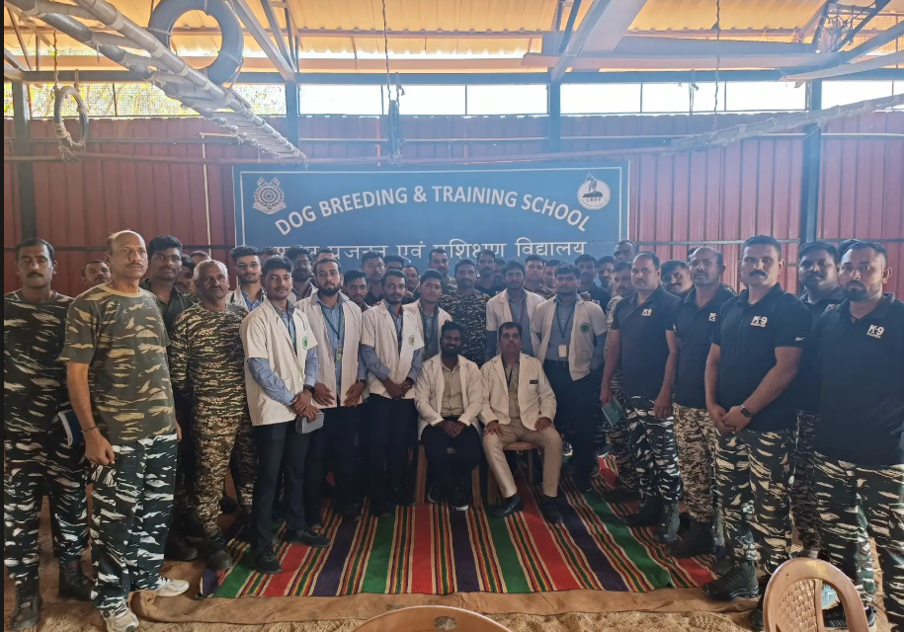
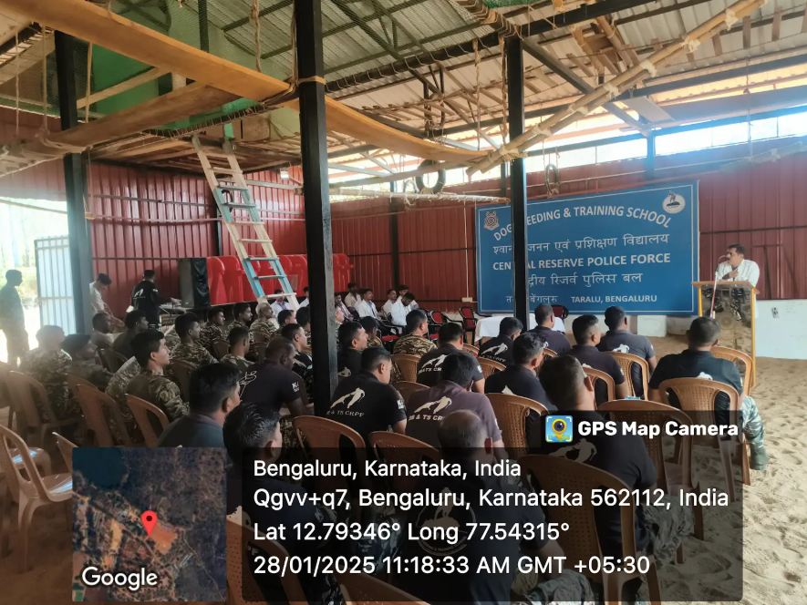
DESH KA PRAKRITI PARIKSHAN
The Desh ka Prakriti Parikshana initiative, under the Ministry of AYUSH, aims to bring Ayurveda to every individual's doorstep by helping people know about their unique Prakriti, or Ayurvedic body type.

Slide 7
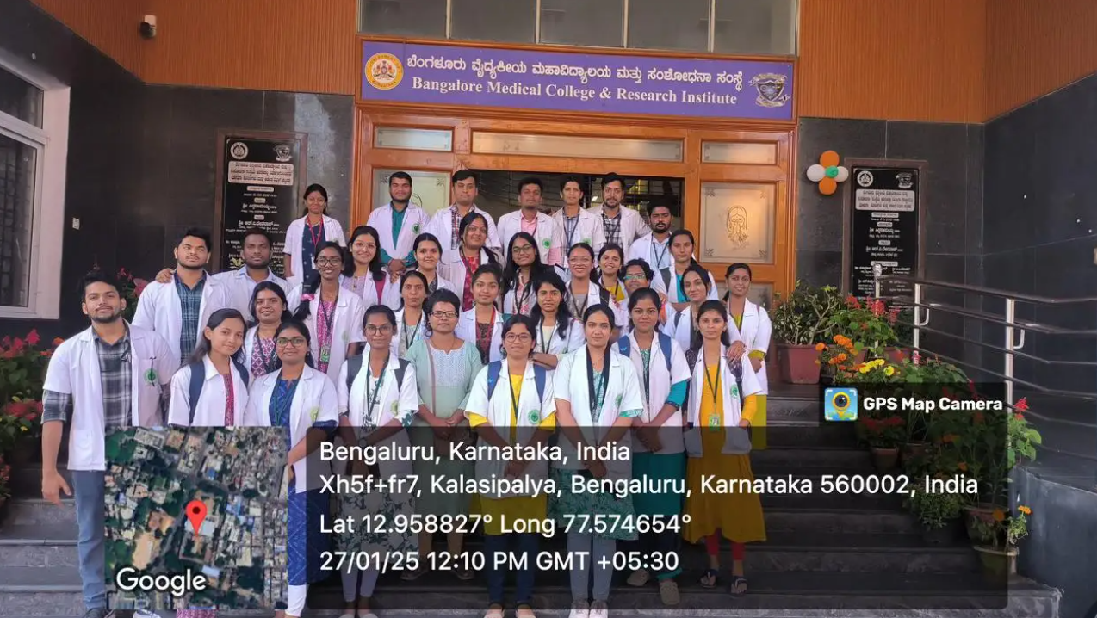
POST - MORTEM POSTING REPORT
As a part of UG curriculum, Post mortem posting was organized by the Department of Agadatantra for the students of 2nd BAMS on 27th and 28th of January 2025 from 9.30am to 5pm.

Slide 8
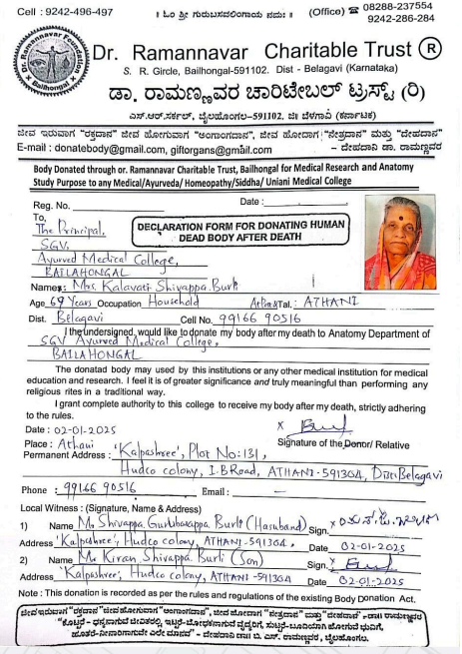
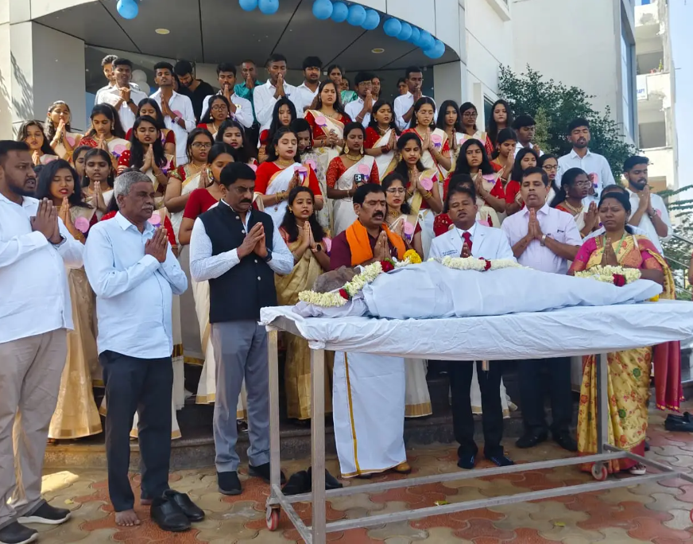
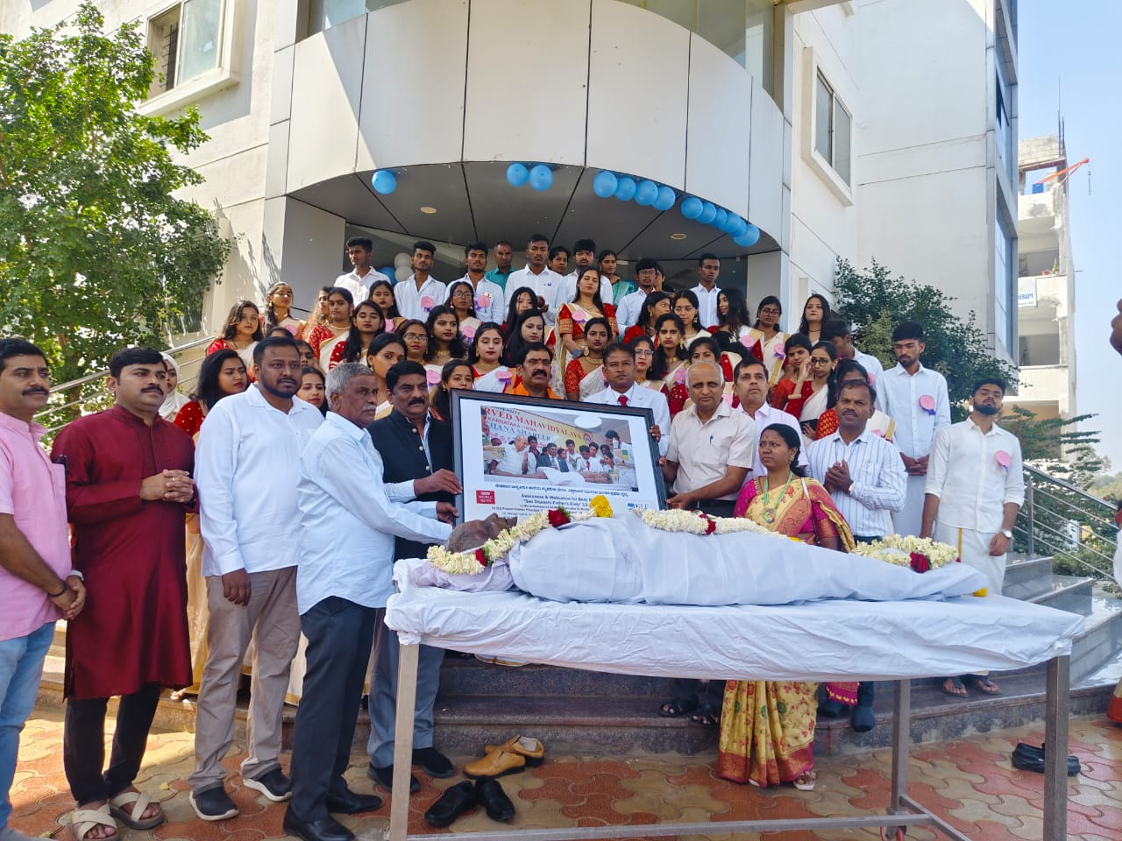
CADEVAR RECIEVING
The Department of Rachana Sharira organized cadaver receiving ceremony on 05.02.2025 from 11.30am. Dr. Mahantesh B Ramannanavar, Professor & HOD, KAHER's Shri BM Kankanawadi Ayurveda Mahavidyalaya, Belagavi and Dr. Shivkumar Appayya Kalyanimath, donated the dead body of Mrs Kalavati through Dr. Ramannavar charitable trust, Belagavi to the Department of Rachana Sharira. The donated body is used by the institution for medical education of the first year BAMS students.

Slide 9
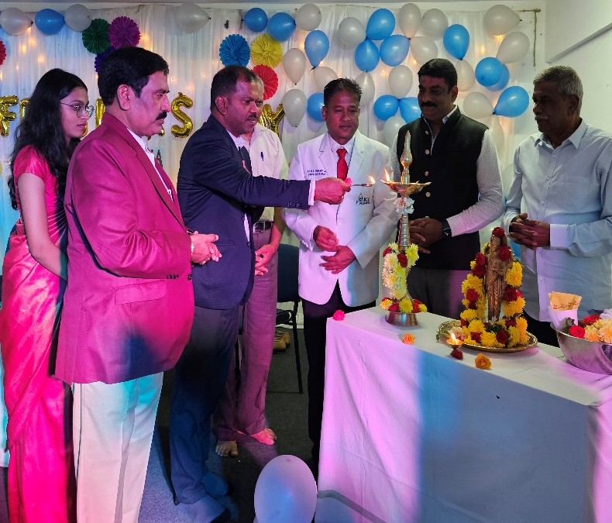
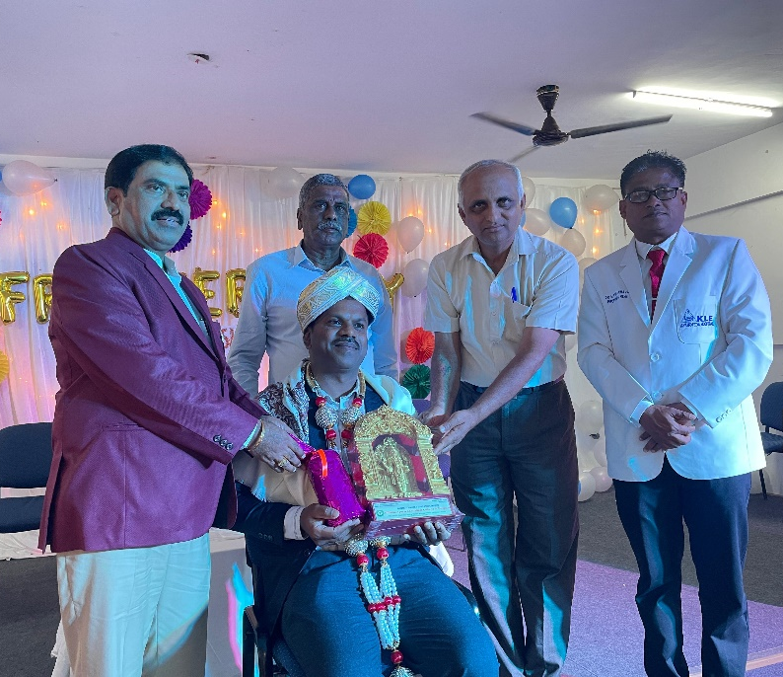
SHISHYOPANAYANA - 2025
Shishyopanayana was held on 05.02.2025 with dignitaries Dr KIRAN KUMAR K, Senate Member of RGUHS, Associate Professor, Sri Kalabyraveshwara Swamy Ayurvedic Medical College and Research Centre, Bangalore, Dr. MAHANTESH B RAMANNANAVAR, Professor & HOD, KAHER's Shri BM Kankanawadi Ayurveda Mahavidyalaya, Belagavi Bengaluru for all the students of first year BAMS.

Slide 10
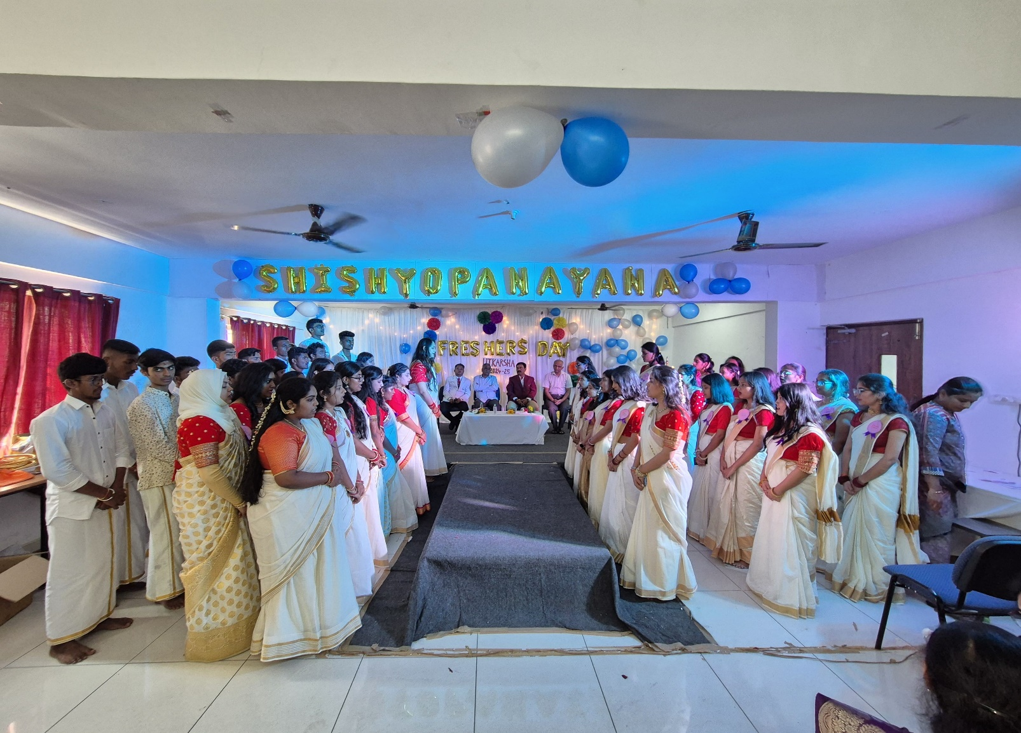

Slide 11
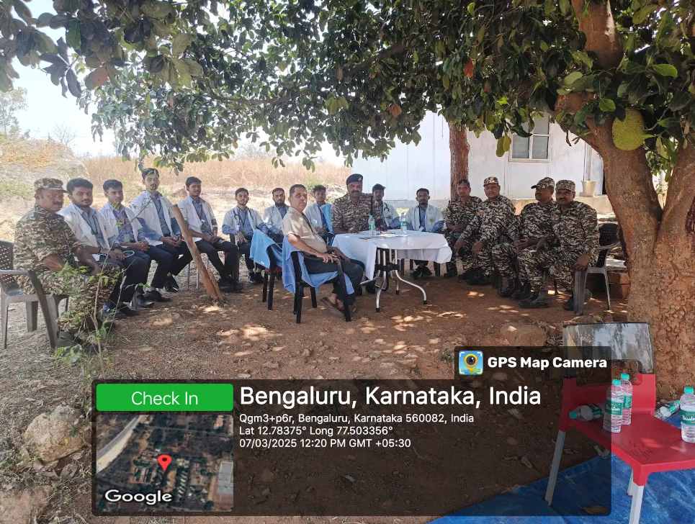
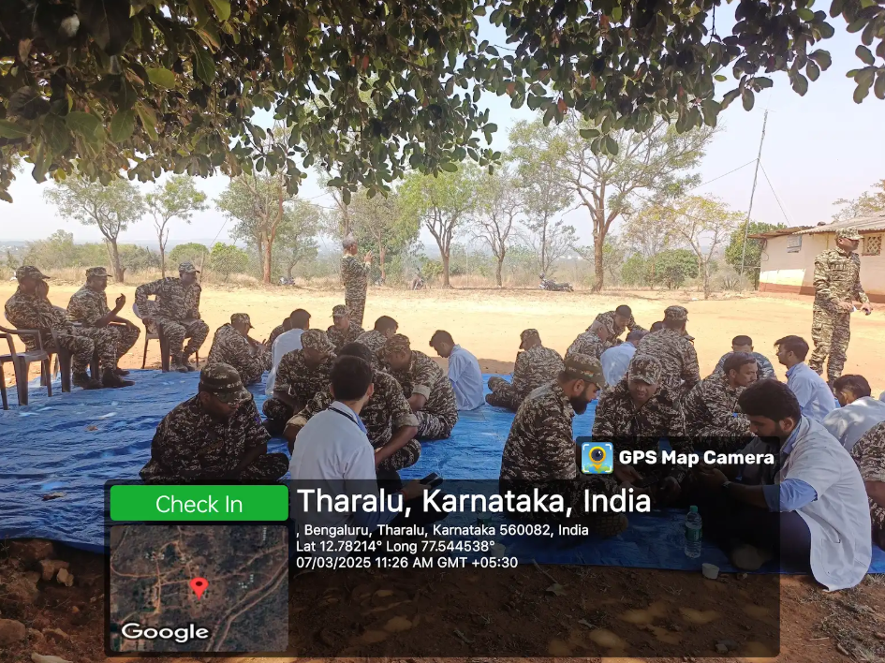
DESH KA PRAKRITI PARIKSHAN
The Desh ka Prakriti Parikshana initiative, under the Ministry of AYUSH, aims to bring Ayurveda to every individual's doorstep by helping people know about their unique Prakriti, or Ayurvedic body type.
With this initiative, our college conducted Prakruti Parikshana program at Dog breeding and training center, CRPF Camp centre, Kaggalipura on 07.03.2025from 10am to 2pm for CRPF staff.

Slide 12
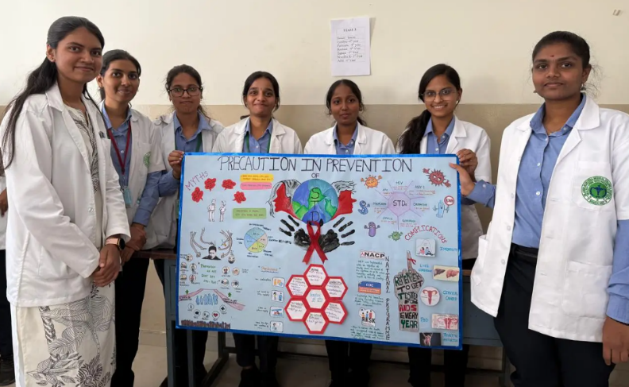
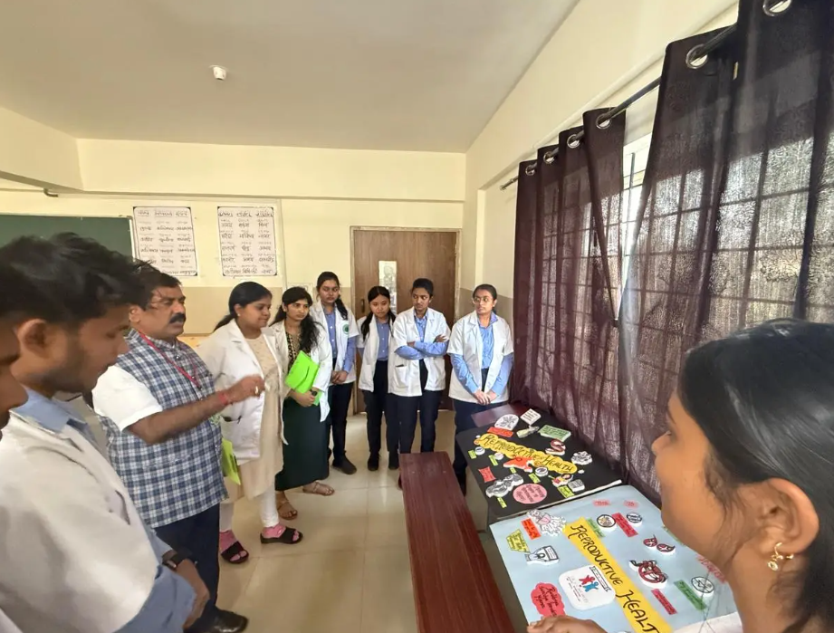
POSTER COMPETITION
The Poster Competition was conducted in HAMCH on 28th of February between 2.30-4.30pm at 2nd Year Classroom. The CME was organized by Department of Prasooti Tantra & Stree Roga, NSS Committee & Department of SwastaVritta.

Slide 13
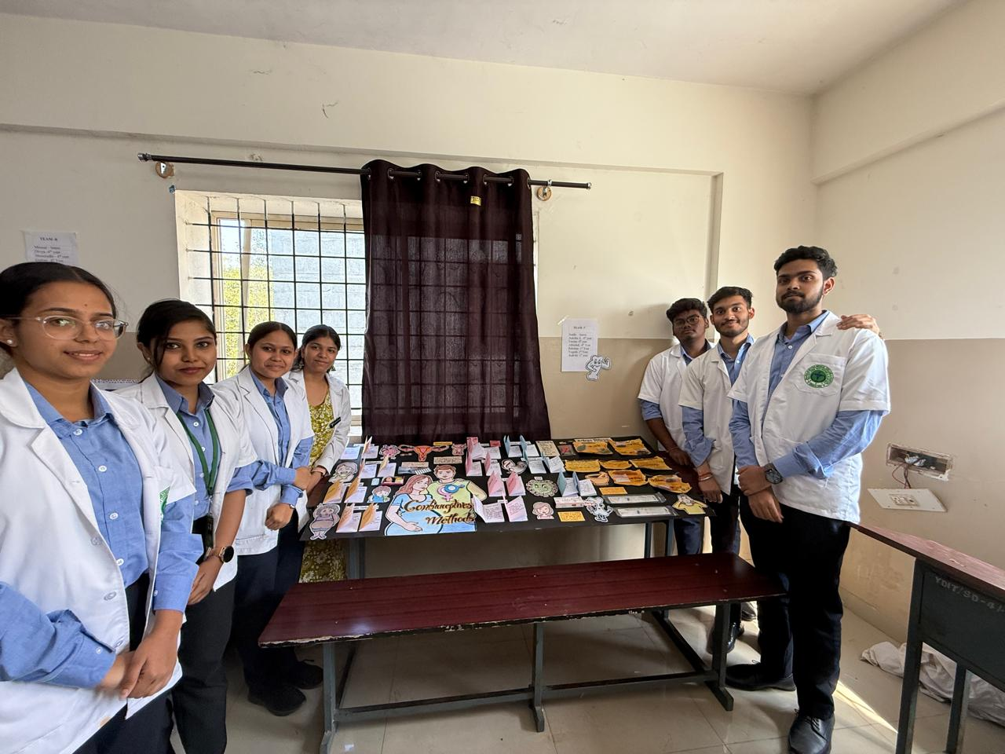

Slide 14
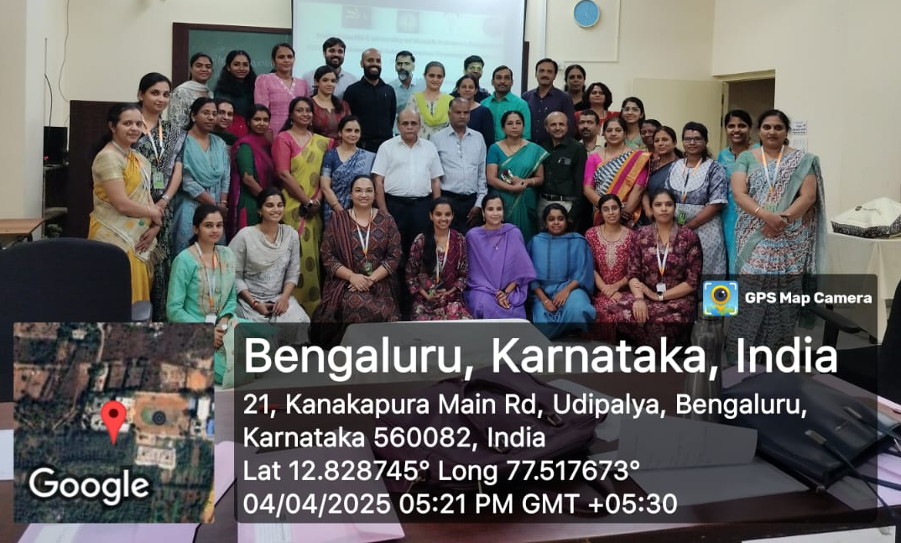
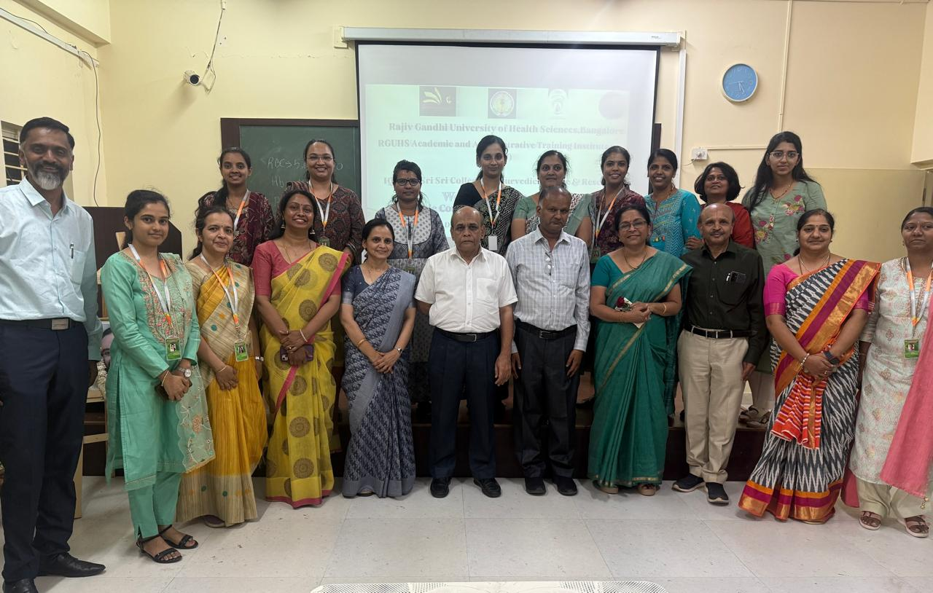
BASIC COURSE IN EDUCATIONAL METHODOLGY TRAINING PROGRAMME
Basic Course in Educational Methodology (BCEM) training programme was organised by RGUHS Academic and Administrative Training Institute (RAATI) in Sri Sri College of Ayurvedic Sciences and Research, Bengaluru on 03.04.2025 and 04.04.2025 from 9.30am to 4pm.
13 teaching faculties from our college participated in the training programme with resource persons Dr. Keerthi G, KLE Institute of Dental Sciences, Bengaluru and Dr. Poornima Chandra, Raja Rajeshwari Dental College, Bengaluru.

Slide 15
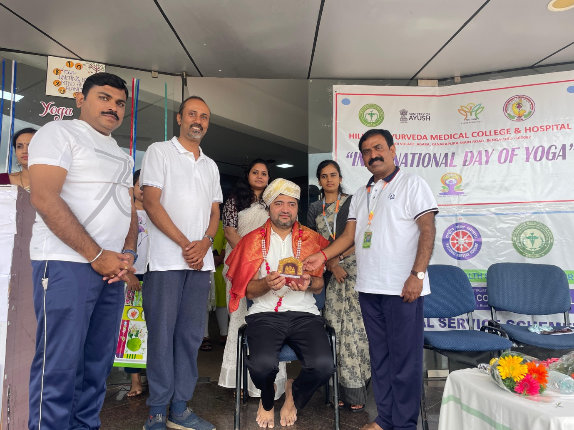
INTERNATIONAL DAY OF YOGA- 2025
International Yoga Day was celebrated on 21st june to raise global awareness about the many benefits of practicing yoga Dr. Vikas Kamath.

Slide 16
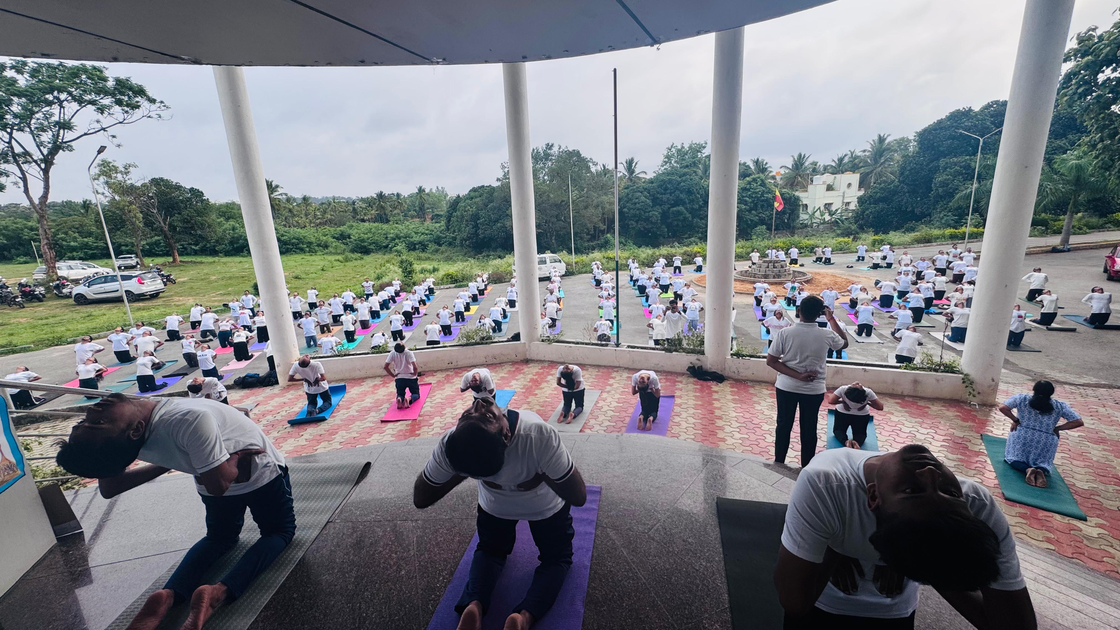

Slide 17
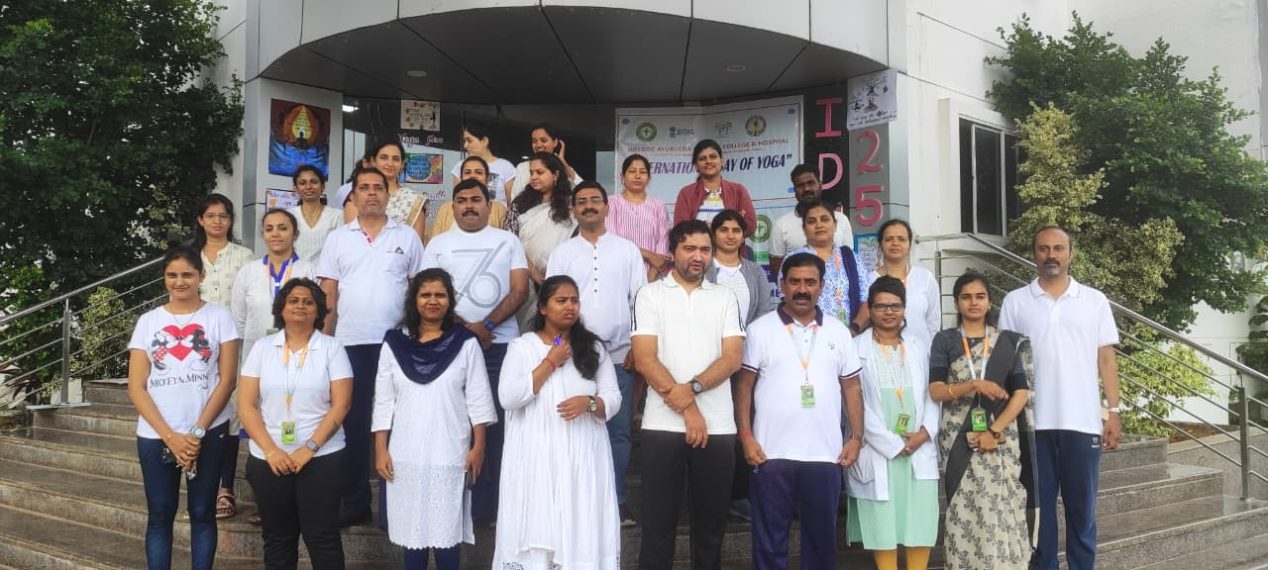

Slide 18
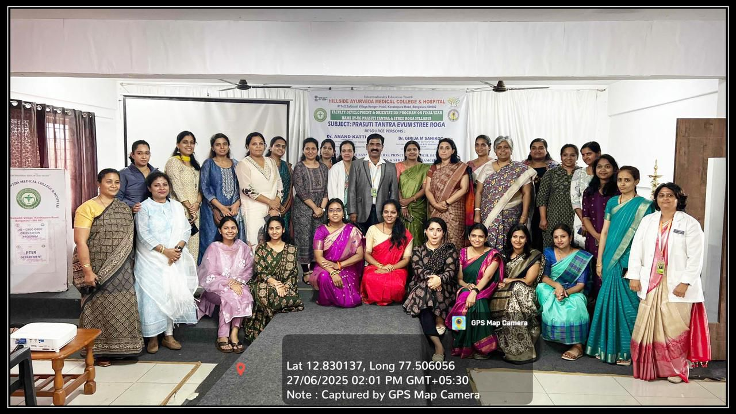
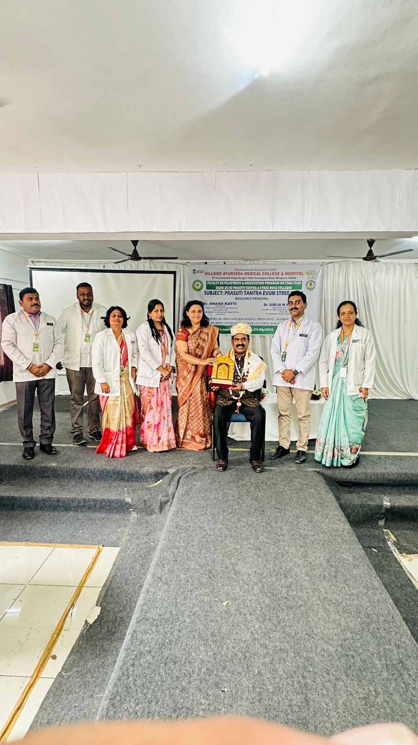
FACULTY DEVELOPMENT & ORIENTATION PROGRAM FOR OBDC-CBDC AYU PS UG SYLLABUS

Slide 19
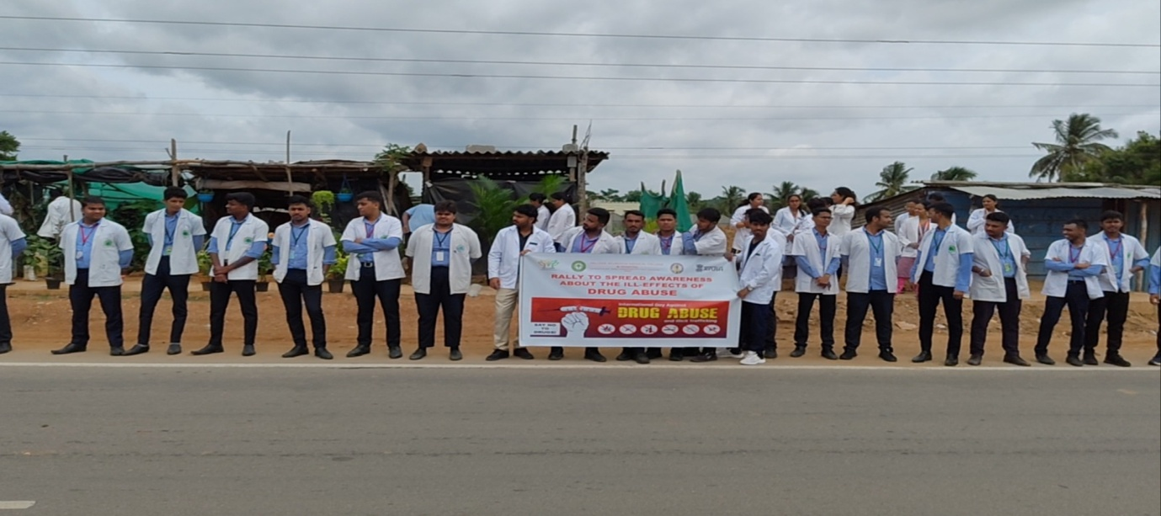
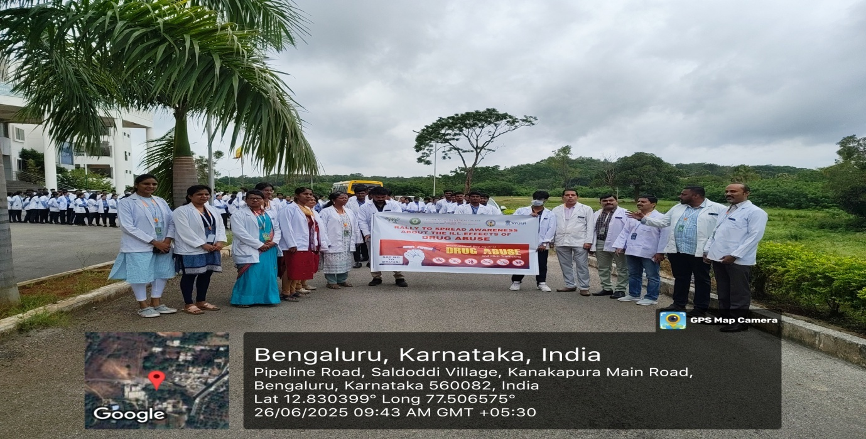
AWARENESS PROGRAMME AGAINST DRUG ABUSE AND ILLICIT TRAFFICKING
Awareness programme against drug abuse and illicit trafficking was successfully organised by the department of Agada tantra and vidhivaidyaka at our college premises and saldoddi to kanakapura main road. 250 students and 30 teaching faculties were actively participated in the same.

Slide 20
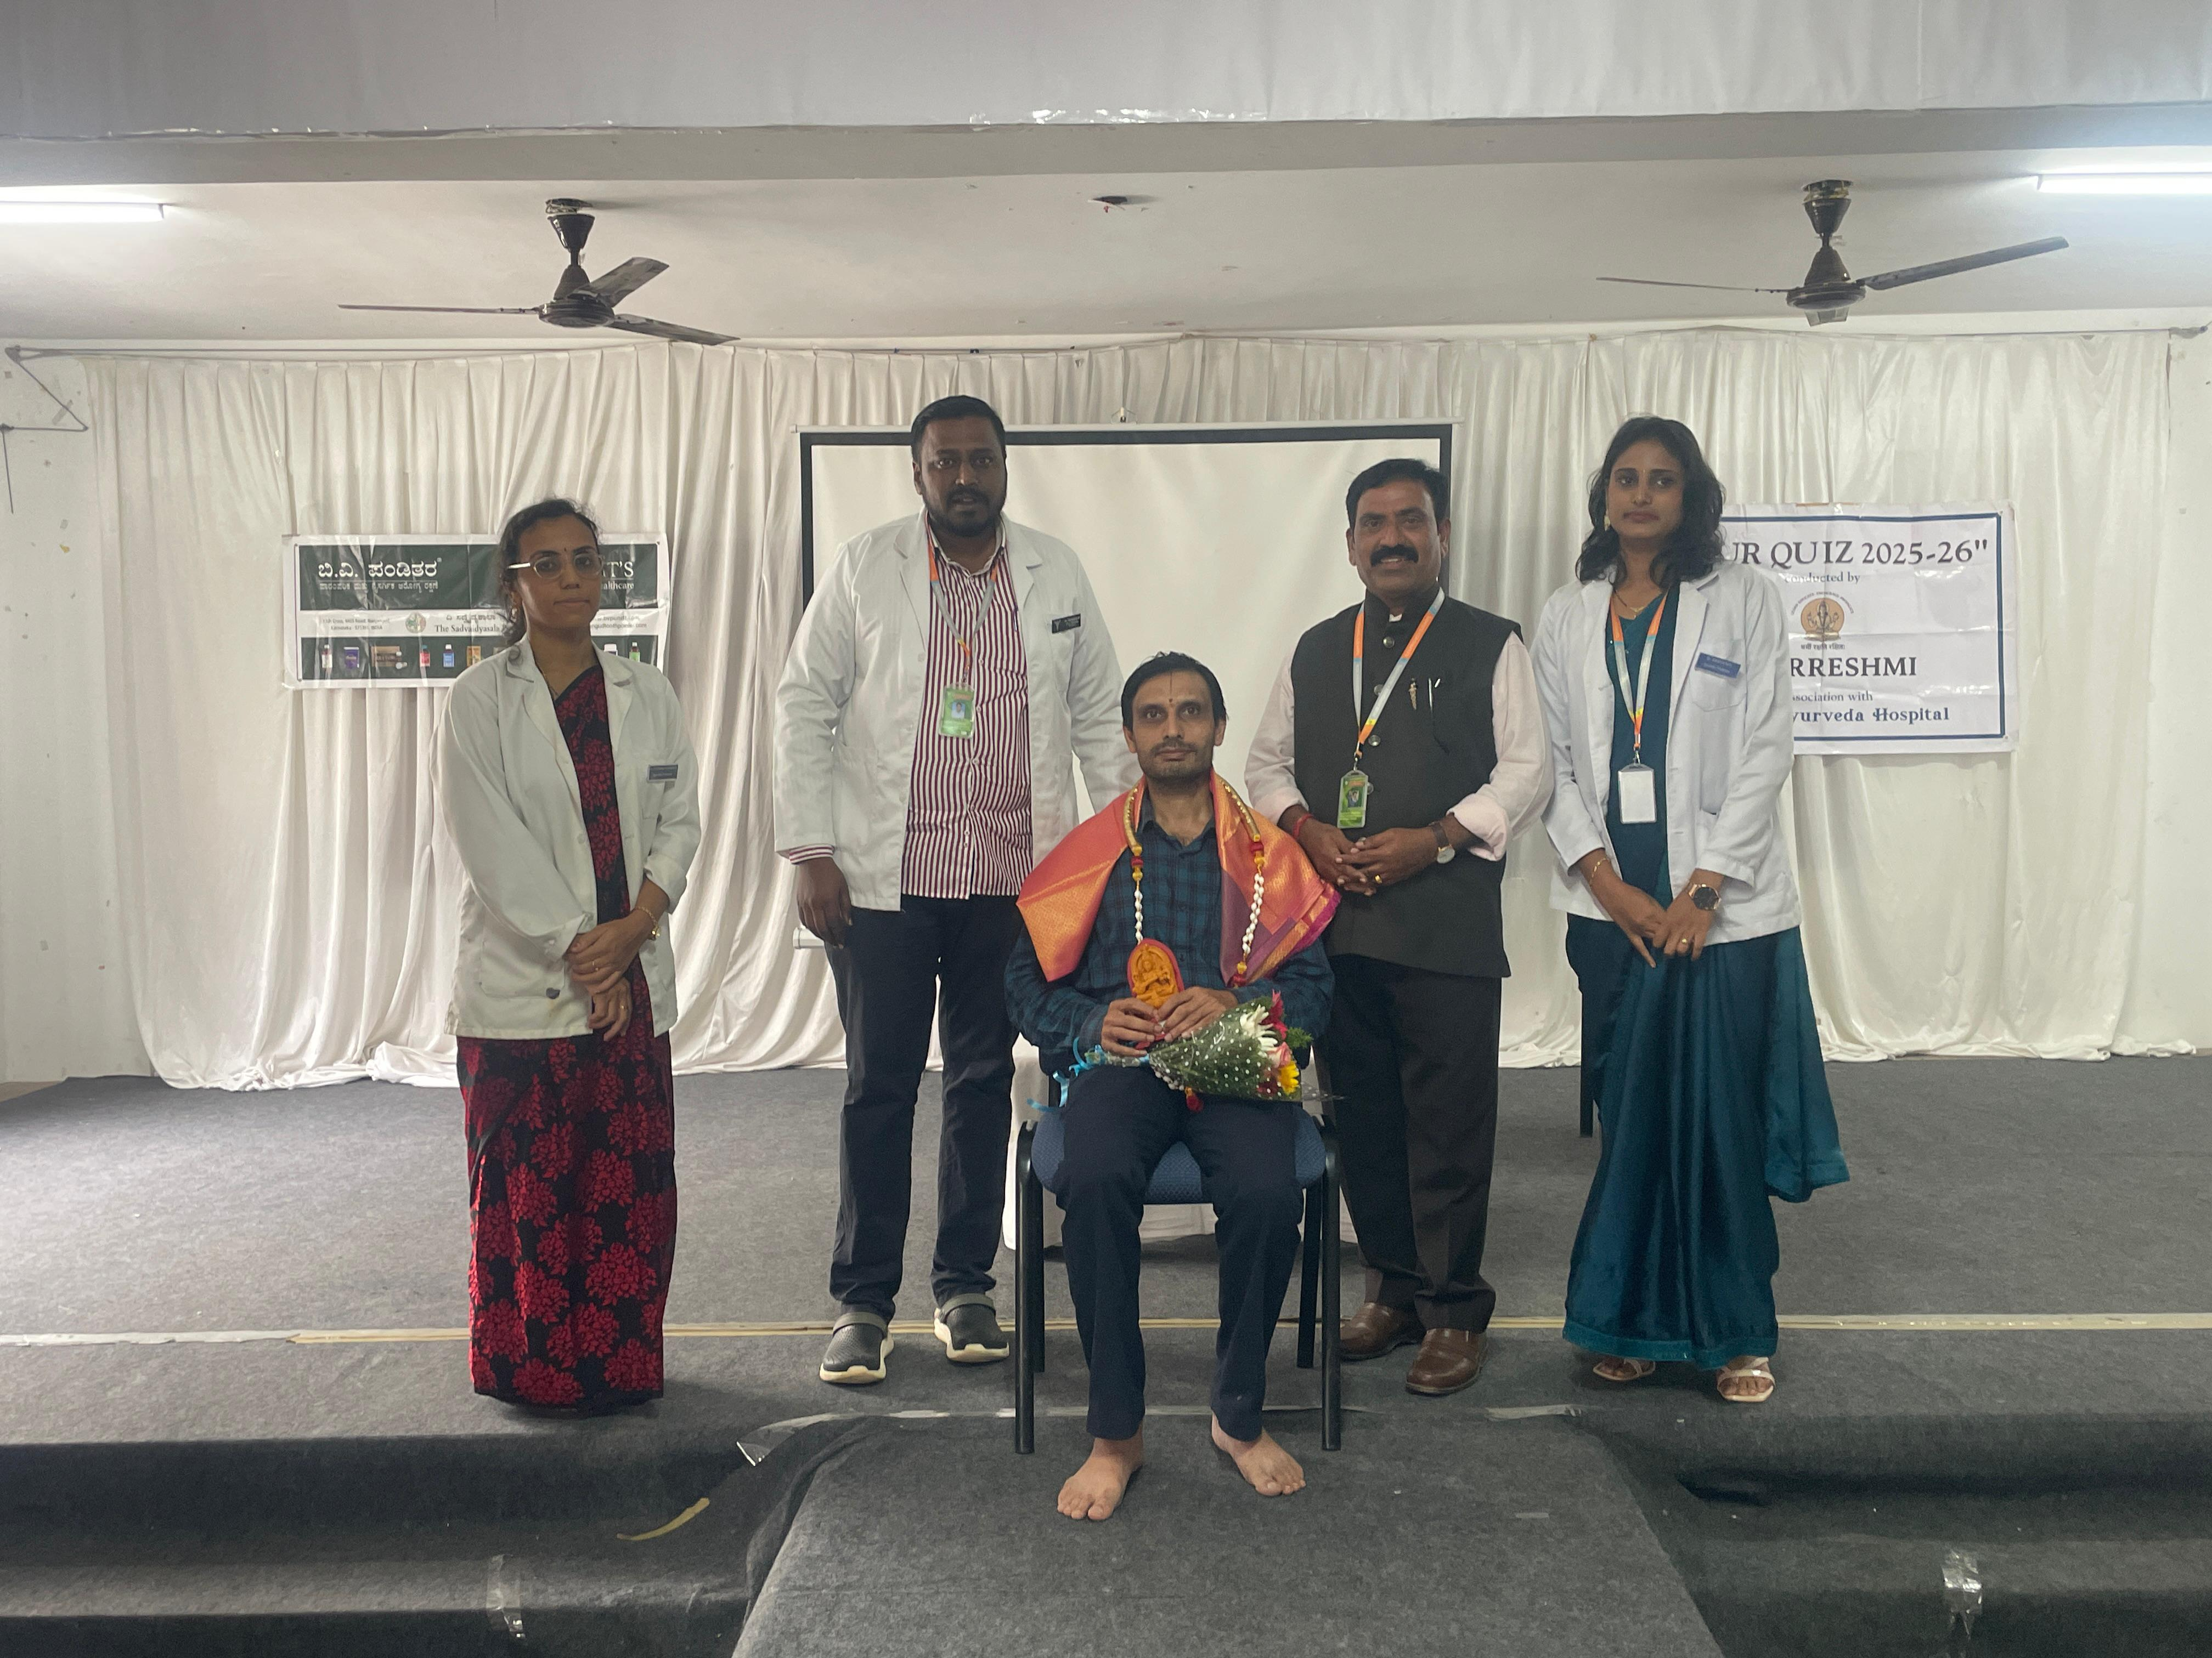
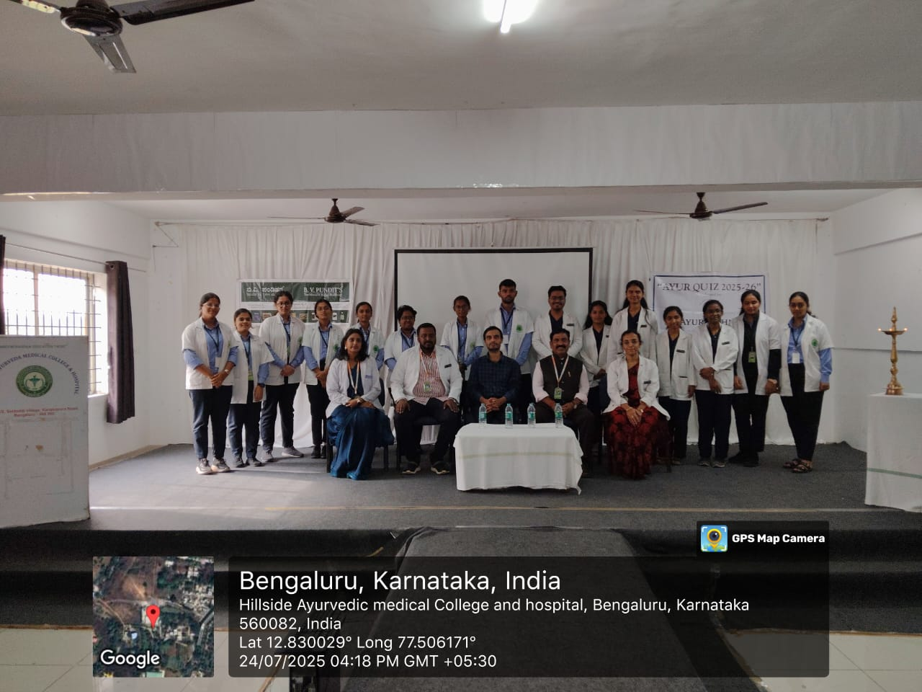
AYURQUIZ
The program began with Charaka Parayana of Sutrasthana 9 (Kudhaka Chatushpada), followed by a briefing on Acharya Charaka, his achievements, and their relevance in the present era

Slide 21
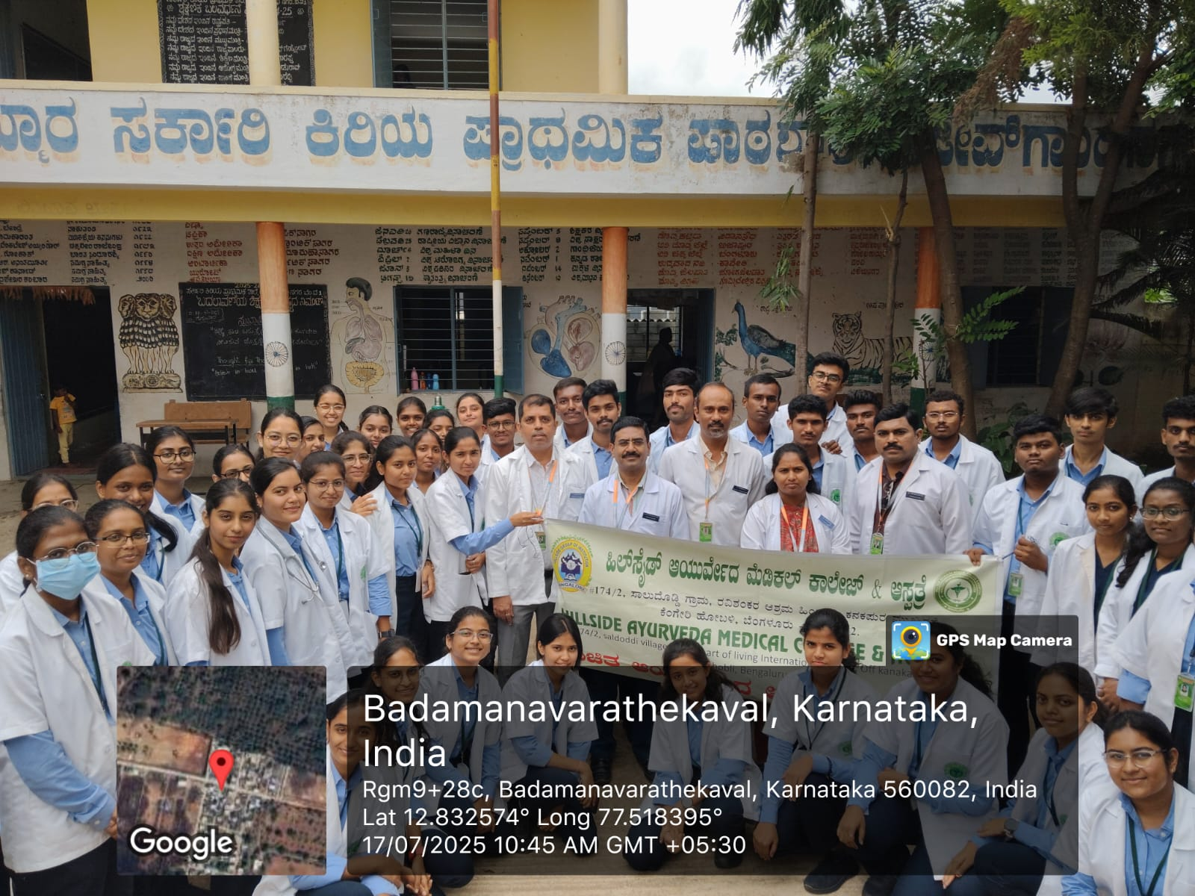
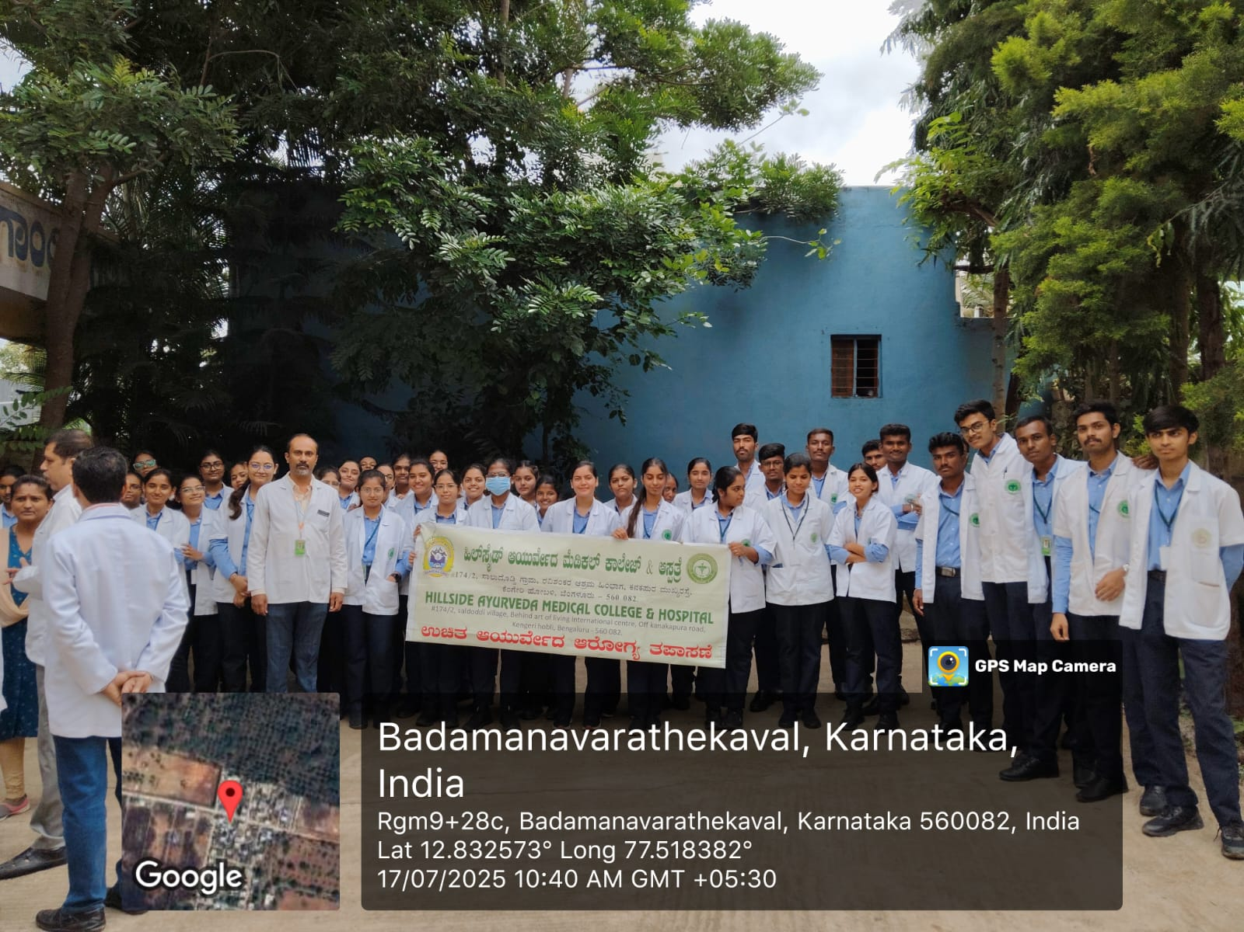
BLOOD GROUPING CAMP
Organised by-department of Kriya sharira
Students learnt the practical proficiency to conduct blood grouping of any given individuals

Slide 22
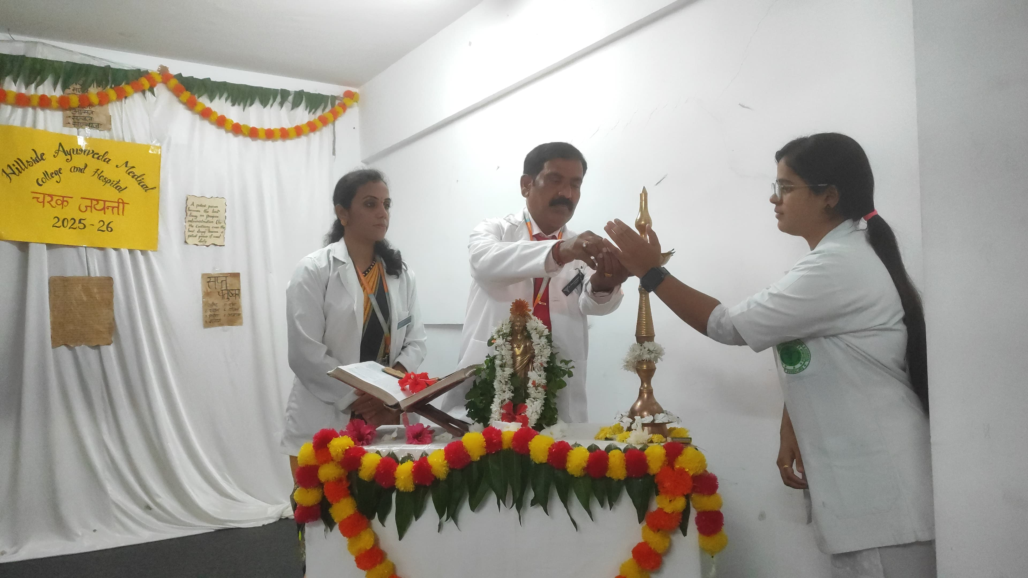
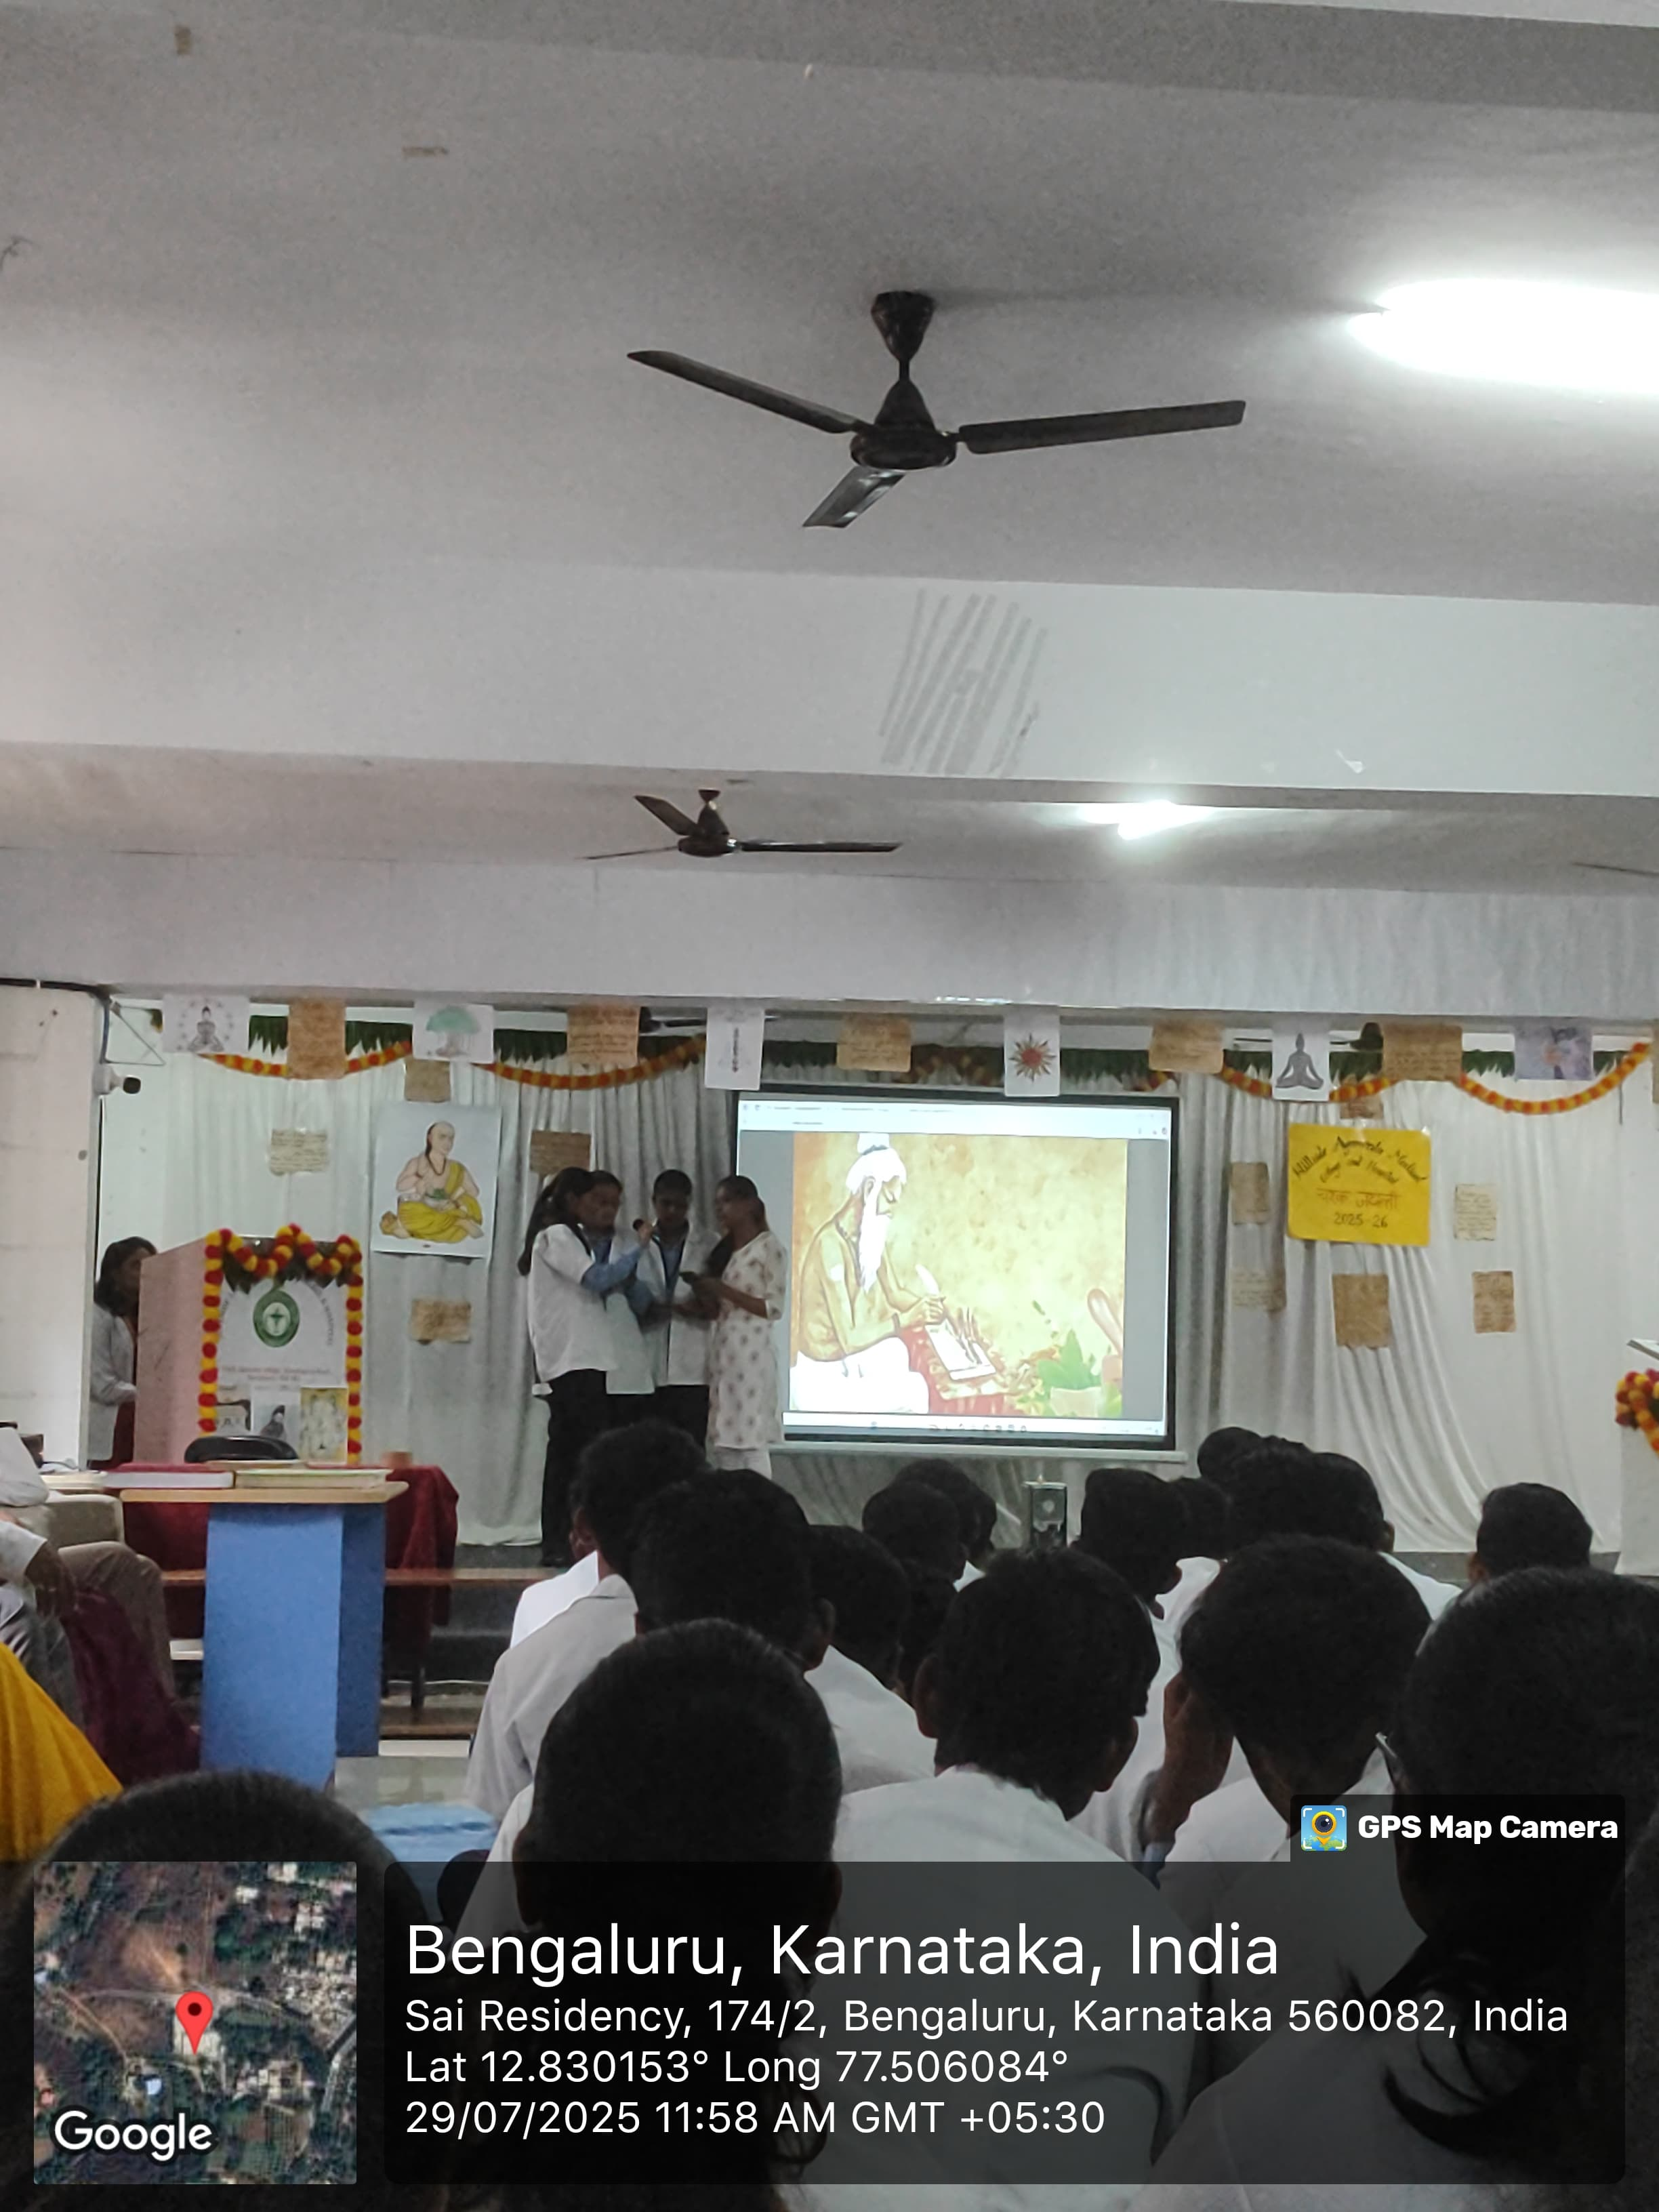
CHARAKA JAYANTI
Organised by-Department of Ayurveda Samhita Siddhanta and Sanskrit

Slide 23
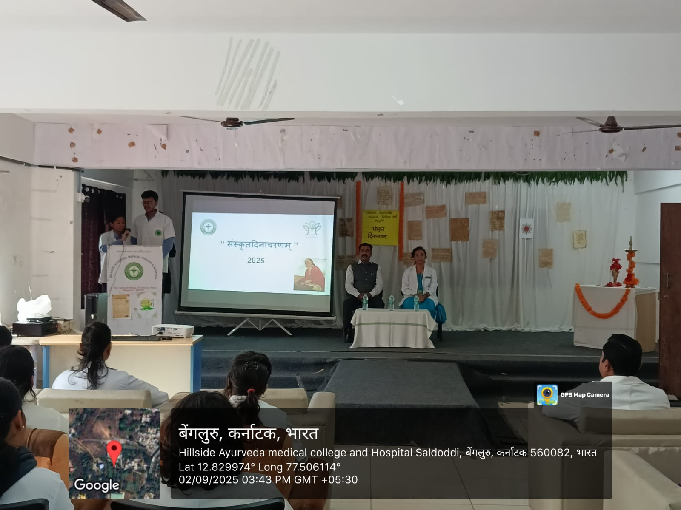
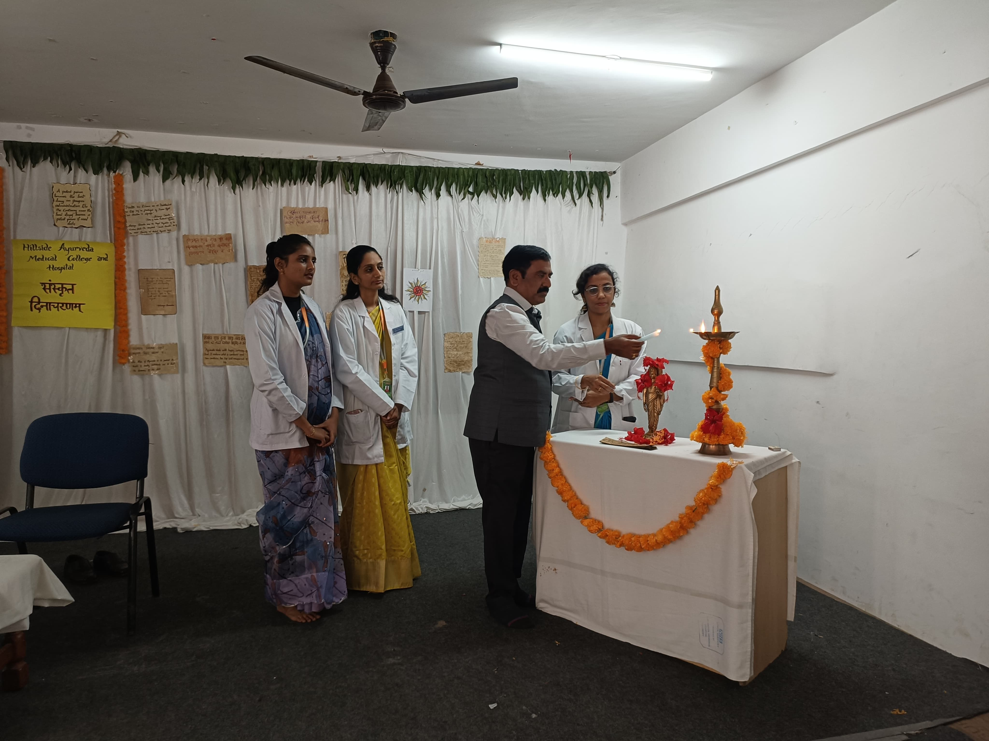
SANSKRIT DAY
Organized by department of Samhita Siddhanta & Sanskrit and Program was gracefully hosted by Sri Ajit Suryakanth Bondre

Slide 24
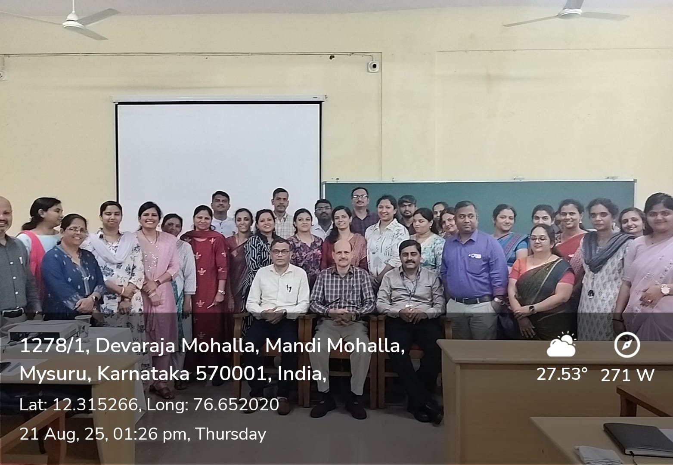
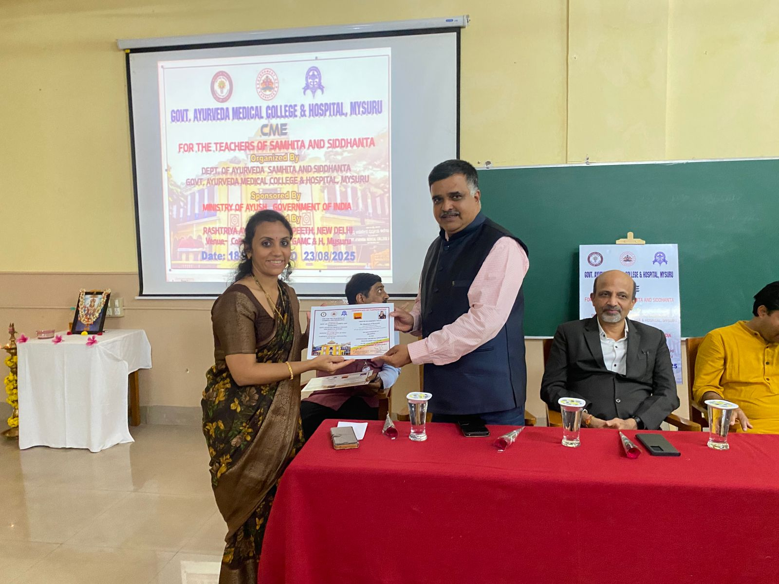
RAV- CME DEPT OF AYURVEDA SAMHITA SIDDHANTA AND SANSKRIT
The CME was conducted in HAMCH, MYSURU from 18th August - 23rd August 2025 . This was the CME conducted for teachers of Samhita Siddhanta Department sponsored by ministry of AYUSH, Govt of India and being coordinated by Rashtriya Ayurveda Vidyapeeth , New Delhi

Slide 25
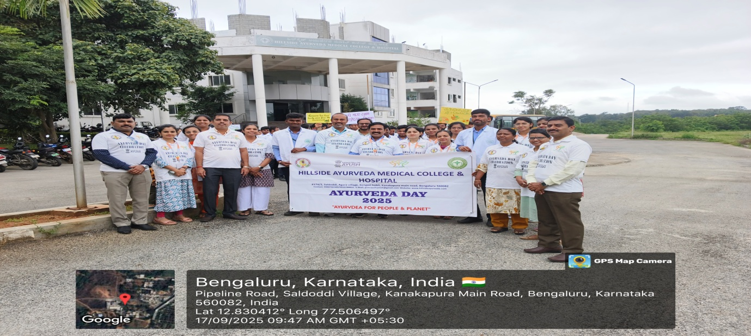
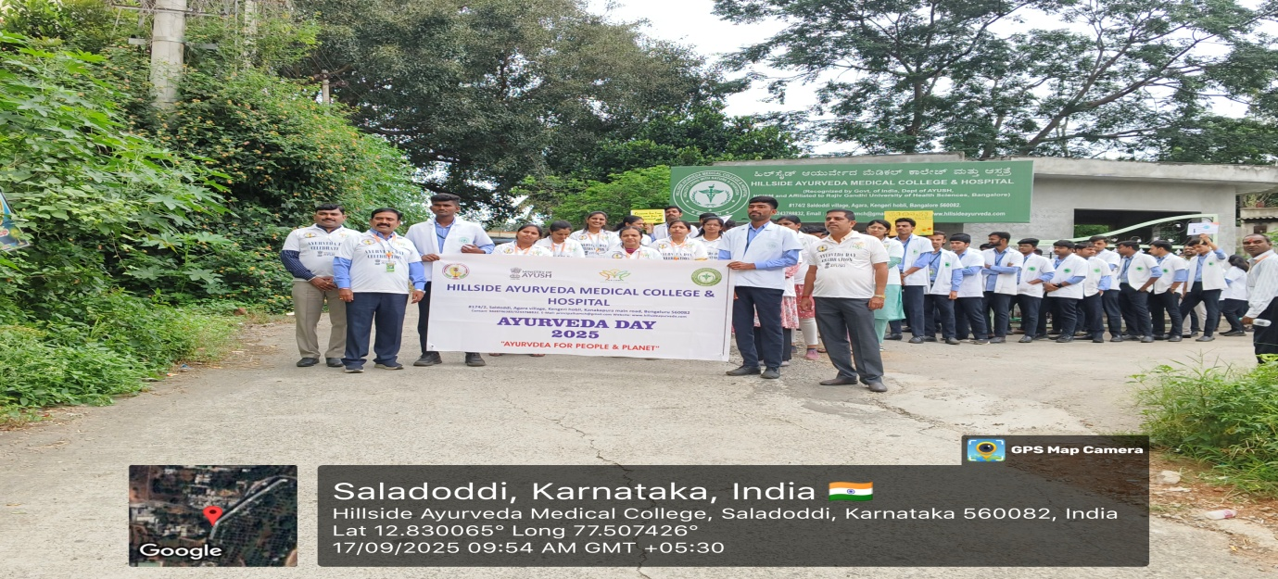
WALKATHON on occasion of AYURVEDA DAY
On the occasion of 10th ayurveda day 2025 a walkathon was organised by Hillside ayurveda medical college and hospital with the theme of ayurveda for people and planet.

Slide 26
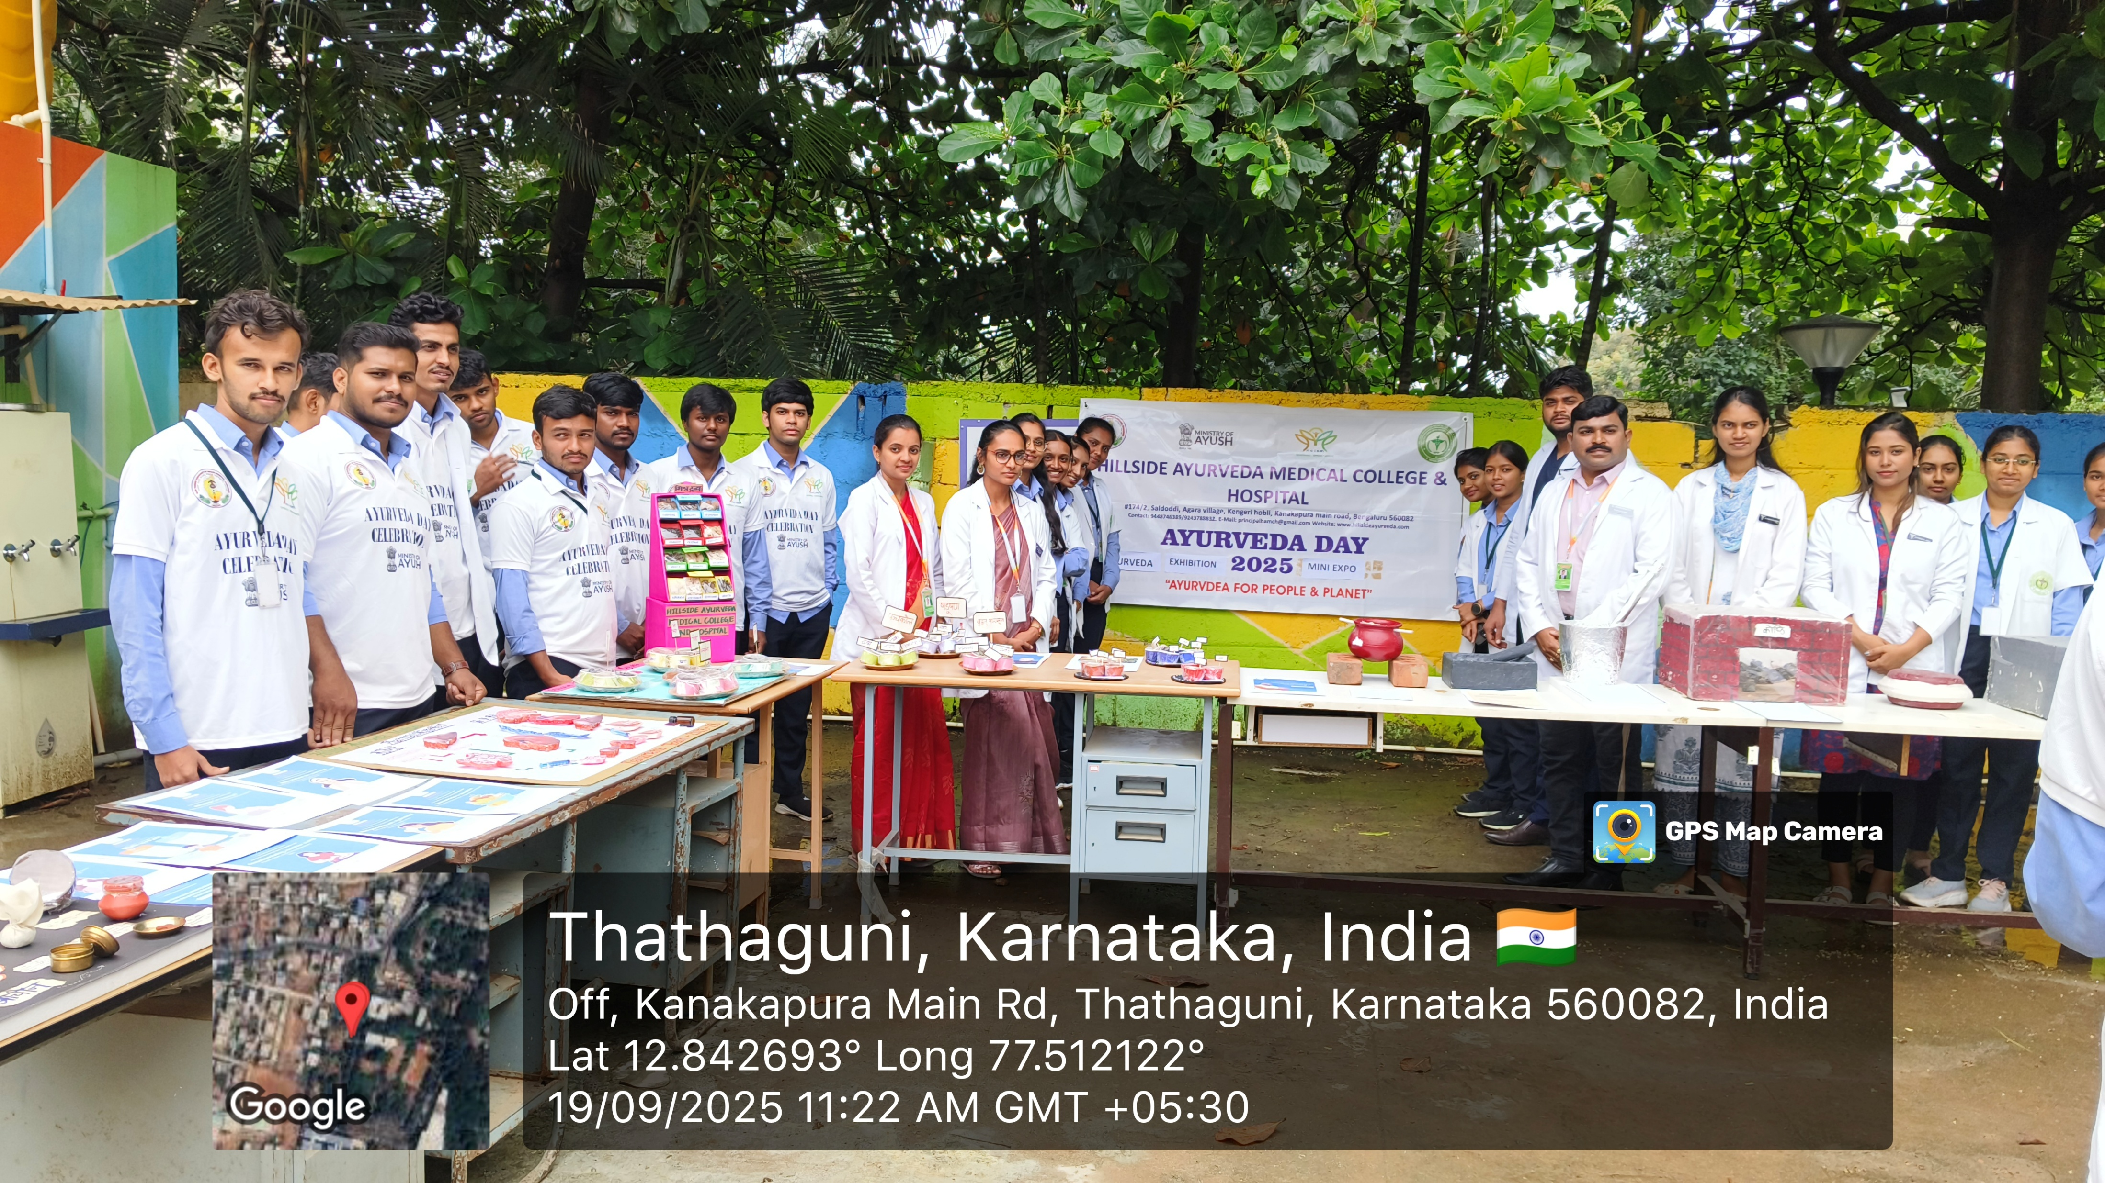
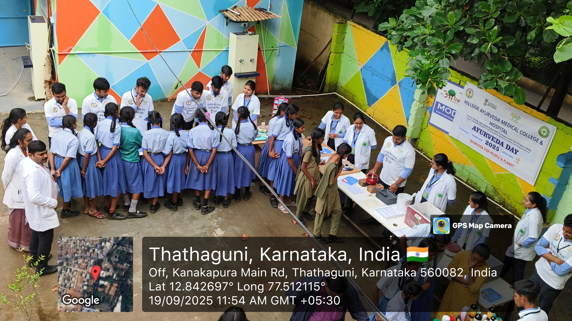
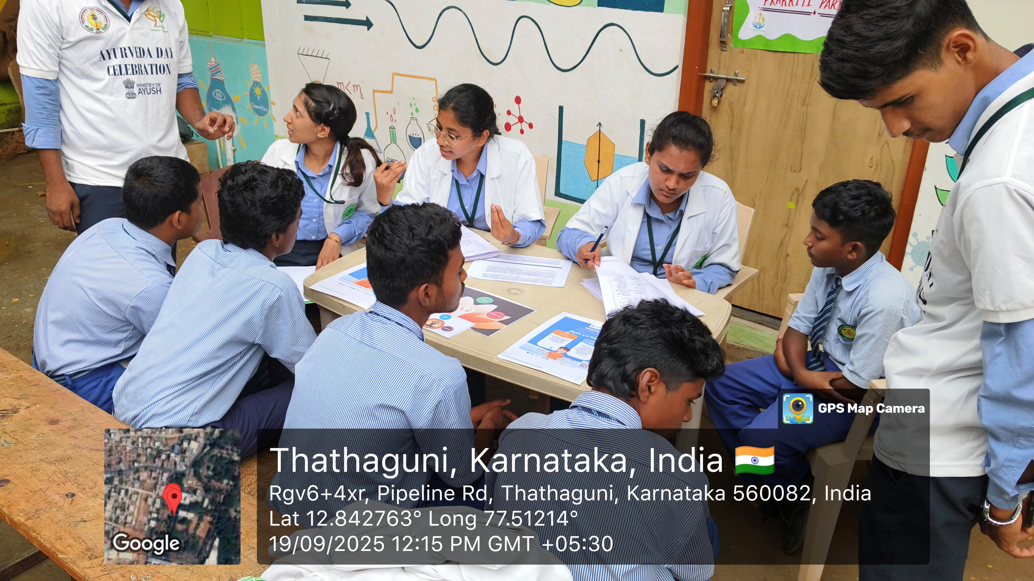
AYURVEDA DAY
MINI EXPO at MARUTHI HIGH SCHOOL TATHGUNI ON 19/09/2025

Slide 27
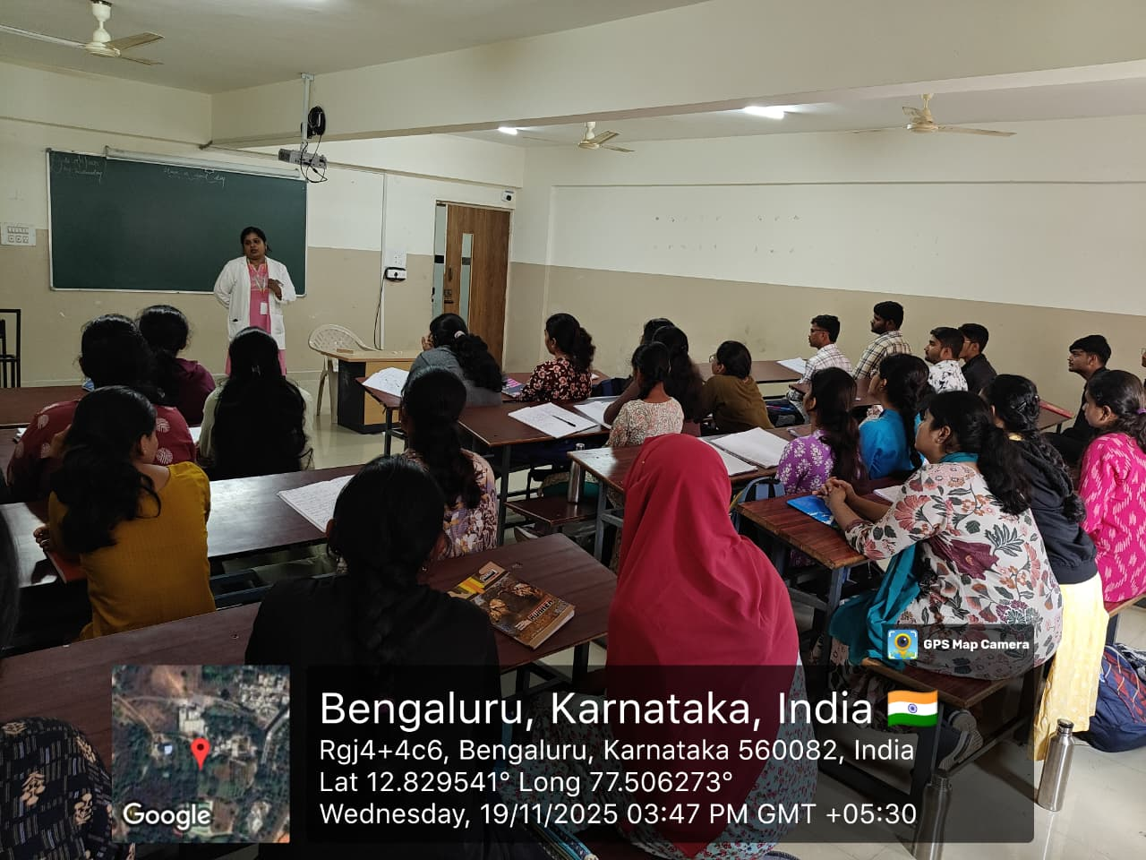
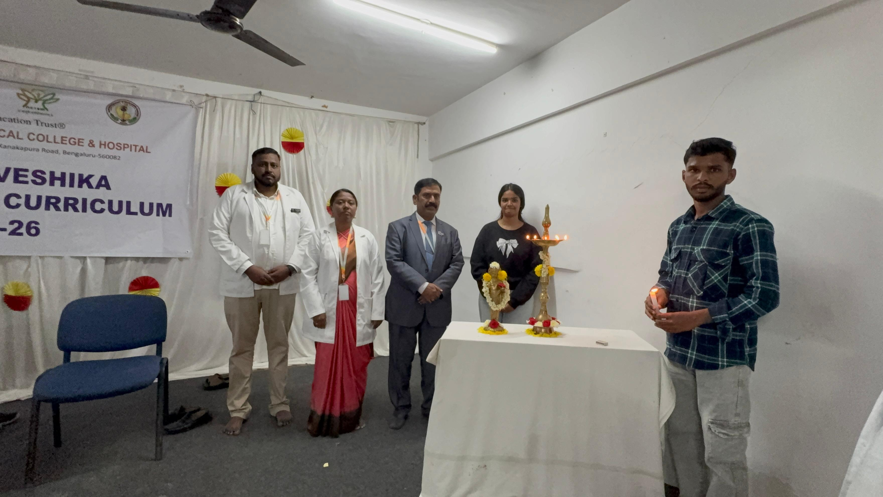
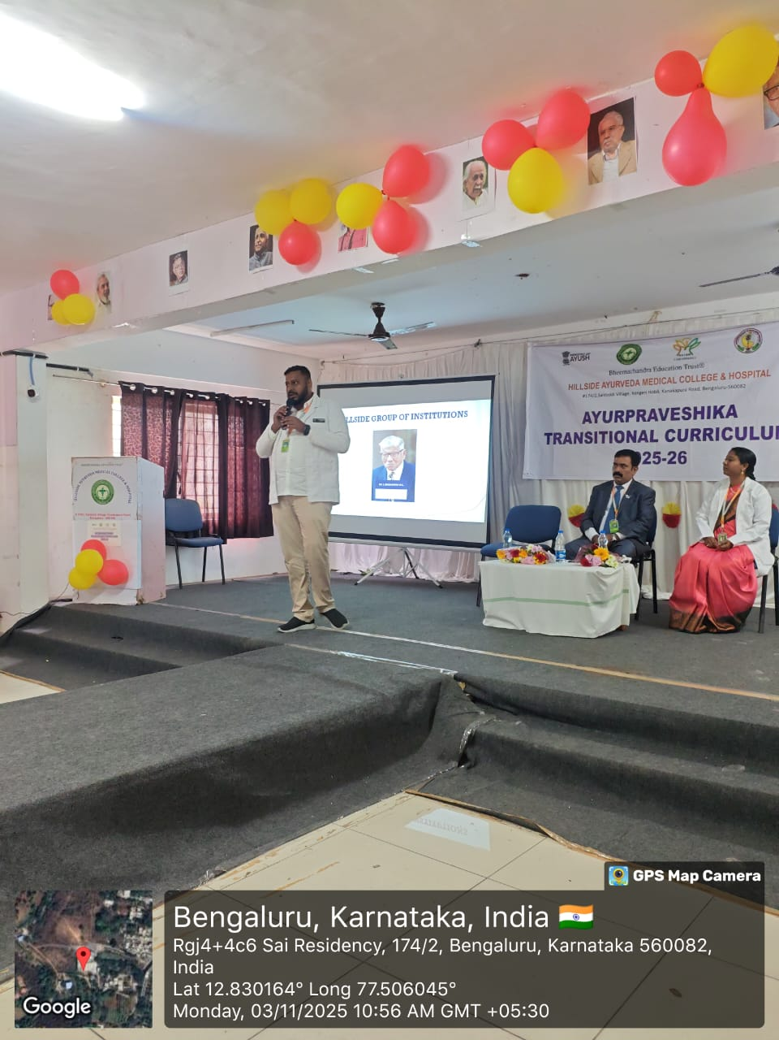
AYURPRAVESHIKA “TRANSITIONAL CURRICULUM-2025”
An orientation program for Fresher’s held on
04/11/2025 to 19/11/2025

Slide 28


ANNUAL SPORTs DAY RGUHS 2025

Slide 29





Slide 30


KAUMARABHRITYA CME on “ dhupa kalpa adhayaya of KASHYAPA SAMHITA“
Dhupa kalapadhyaya of kashyapa Samhita: A pragmatic & Research -oriented appraisal

Slide 31


All India Inter University Yoga Selection trails for representing RGUHS
All India Inter University Yoga Selection trails for representing RGUHS held on 27 oct 2025 to 28 oct 2025

Slide 32



NUTRITION WEEK
A Continuing Medical Education (CME) programme on the theme “The Ayurvedic Nutrition Lens: Decoding Modern Diets with Ancient Wisdom” was organized by the Department of Swasthavritta.

Slide 33


NUTRITIOUS MEAL PREPARATION COMPETITION USING NITYASEVANEEYA DRAVYAS
The Nutritional Meal Plate Preparation Program using Nityasevaneeya Ahara was conducted with the objective of creating awareness about the importance of balanced meals, significance of Nityasevaneeya Ahara, hygienic cooking practices, and time management in food preparation.

Slide 34


WORKSHOP ON KRIYAKALPA

Slide 35




Slide 36


GENeRAL CAMP
ON 31-07-2025 GENERAL CAMP HELD AT MARUTHI HIGH SCHOOL TATHGUNI

Slide 37





Slide 38


Slide 39


PUBLIC AWARENESS PROGRAMME - HEALTH TALK
A Public Awareness Programme was organized on 16th September 2025 at Anganavadi, Saludoddi Grama, Bengaluru on the theme “Nutritious Diet for Preventing Obesity.”

Slide 40


SCHOOL OUTREACH PROGRAMME
The school outreach programme was organized on the occasion of Ayurveda day, an interaction with students regarding Ayurveda principles like Dinacharya, Viruddha Ahara and common ailments of the students were addressed with simple ayurveda health tips to improve the quality of life.

Slide 41


PUBLIC AWARENESS PROGRAMME - STREET PLAY
A Public Awareness Program was conducted by the Department of Swasthavritta and Yoga as part of community outreach activities, with the theme “Lifestyle Management through Ayurveda.”

Slide 42




CME on PHARMACOVIGILANCE
The CME was conducted in HAMCH on 23rd of January 2025 between 2 to 3.30 pm at Dhanvantari Hall. The guest speakers of the day Dr. Shubhashree M N MD(Ayurveda) Senior research officer, CARI, Bangalore and Dr. Arsha K S MD(Ayurveda) Junior research officer, CARI, Bangalore

Slide 43


SPORT’S DAY
The annual sports day of Hillside Ayurveda Medical college was held with great enthusiasm and excitement. The event was organised in Vrishi Badminton and Shuttles Arena Raghuvanahalli for badminton and rest all sports in saldoddi campus, inauguration done by our principal sir and all other faculties, students were present at opening ceremony of KHEL 2025.

Slide 44

CRICKET CHAMPION 2025 HAMCH

Slide 45


CULTURAL EVENT-SAMANTHA
The Cultural Fest was successfully organized in college with active participation from students. Various events such as theme wise dress code like retro style 1st day 2nd day ethnic wear and 3rd day twinning

Slide 46


SAMANTHA

Slide 47

EThNIC DAY

Slide 48

BOLLYWOOD DAY

Slide 49

RETRO DAY

Slide 50


CCRAS-CME
"Madhumeha Vichara “ by Prof. GG Gangadhar program at the CCRAS - Central Ayurveda Research Institute, Bengaluru

Slide 51



CME KAYACHIKITSA ON
“SANDHI VATA IN LENS OF CLINICIAN”
A Continuing Medical Education (CME) program was successfully organized by the Department of Kayachikitsa at our college on 22nd May between 2:00 PM and 4:00 PM, at the Dhanvantari Hall in the presence of 110 students and 25 teaching faculty.

Slide 52



TEACHERS DAY 2025
Teacher’s day was celebrated on 9th September 2025 by the students. Students conducted number of competitions and fun games where all the staffs participated actively. On this special day all the staff came together to express gratitude and appreciation for the tireless efforts of our teachers, who not only impact knowledge but also shape our character and guide us towards a bright future.

Slide 53



FOUNDER'S DAY CELEBRATION
The Founder's day was successfully conducted on 26/07/2025 at Dhanvantari auditorium, bringing together all the teaching and non teaching staff's of Hillside group of institution, and esteemed guests for a vibrant and memorable occasion.

Slide 54

INDEPENDenCE DAY
The 79th Independence Day was celebrated with great enthusiasm and patriotic fervor on 15th August 2025. The event was organized on the college grounds and witnessed active participation from Dignitaries, Staff’s & students.

Slide 55


Slide 56

BASIC COURSE IN EDUCATIONAL METHODOLGY TRAINING PROGRAMME REPORT
Basic Course in Educational Methodology (BCEM) training programme was organised by RGUHS Academic and Administrative Training Institute (RAATI) in Sri Sri College of Ayurvedic Sciences and Research

Slide 57


BASIC LIFE SUPPORT TRAINING (BLS)
Interns were given Hands on Training by Dr. Rajesh G Hiremath on Basic Life Support.

Slide 58


Roga Nidana CME on
“IDENTIFICATION AND INTERPRETATION OF DOSHA VITIATION IN ROUTINE OPD CASES”

Slide 59
RESEARCH GRANTS RECEIVED FROM RGUHS
RESEARCH TITLE | PRINCIPAL INVESTIGATOR
1. EARLY PUBERTY DETECTION IN CHILDREN AND UTILIZING BHRAMI GHRITA NASYA AND BHRAMI CHURNA TALAM FOR SYMPTOM DELAY | Dr. AMBILY V.N. , Dr. SHRUTI B.V.
2. A CLINICAL STUDY TO EVALUATE THE BALYA ACTION OF KBT 101 CAP. W.S.R. TO GRISP POWER STRENGTH | MS. MRUNAL (INTERNEE)
3. AN OPEN LABELED CLINICAL STUDY TO EVALUATE THE EFICACY OF SIRA VYADH IN MEDO DUSTHI WITH SPECIAL REF. TO DYSLIPIDAEMIA | MS . JAYASHREE (3RD BAMS)
4. A COMPARATIVE CLINICAL STUDY TO ASSESS EFFECT OF DURVADI TAILA AND MURCHITA TILA TAILA IN DARUNAKA | MS. VEENA (3RD BAMS)

